Slide 1
Country Music’s long relationship with alcohol
Thomas R. Hochschild JR.
Lorna Alvarez-Rivera
Ellis Logan
Valdosta State University

Slide 2
Country music as a brand

Slide 3
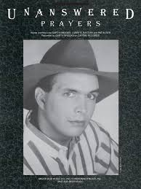
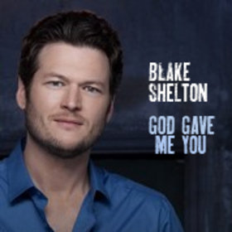
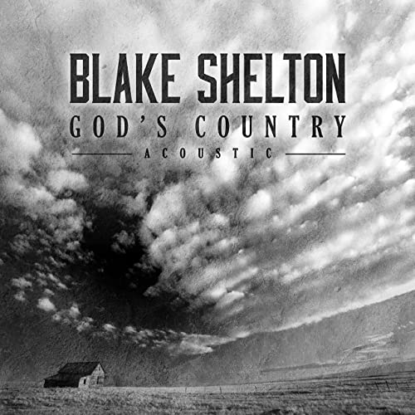
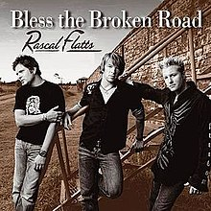
Religious (Christian)

Slide 4
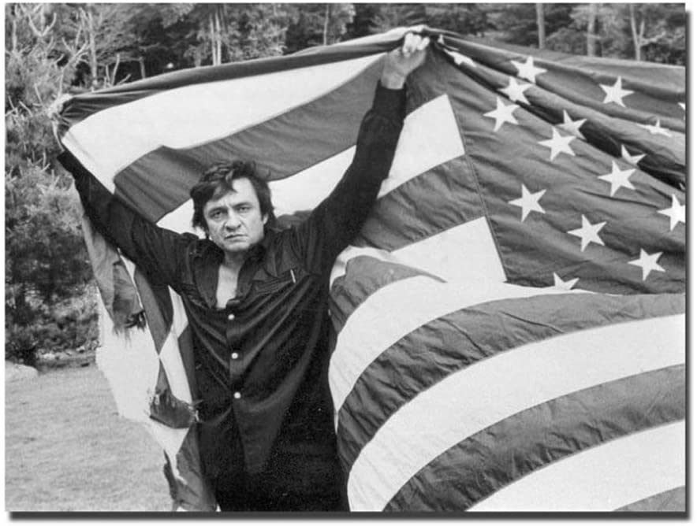
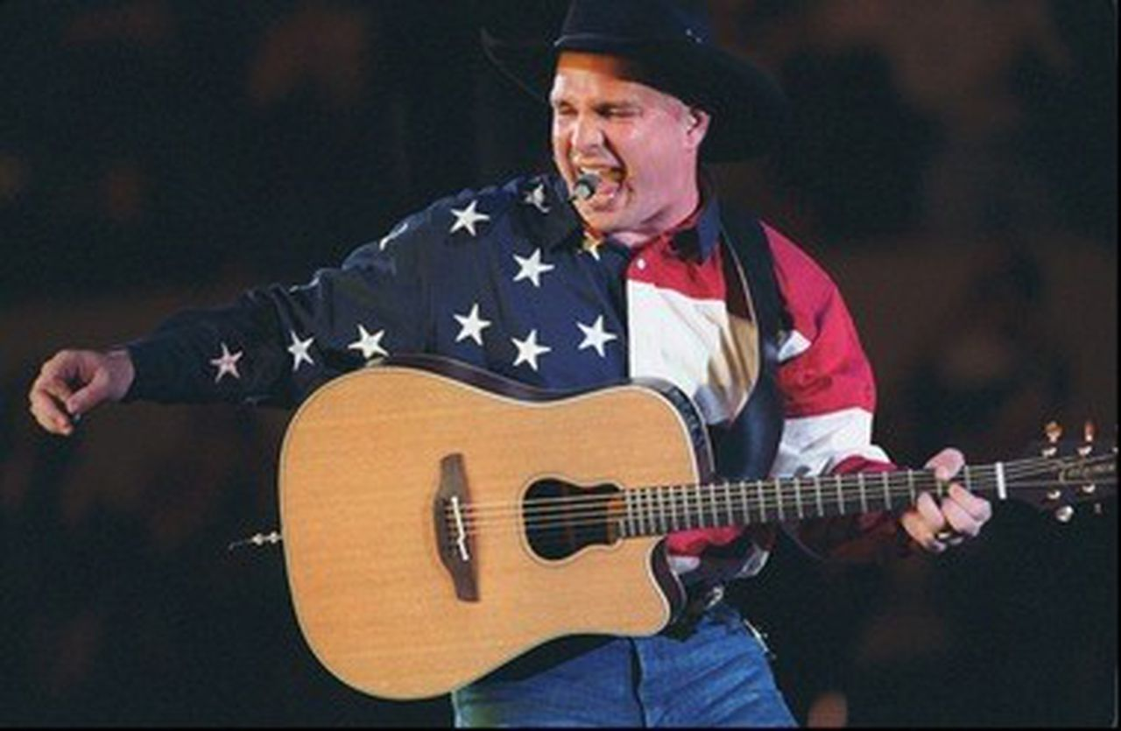
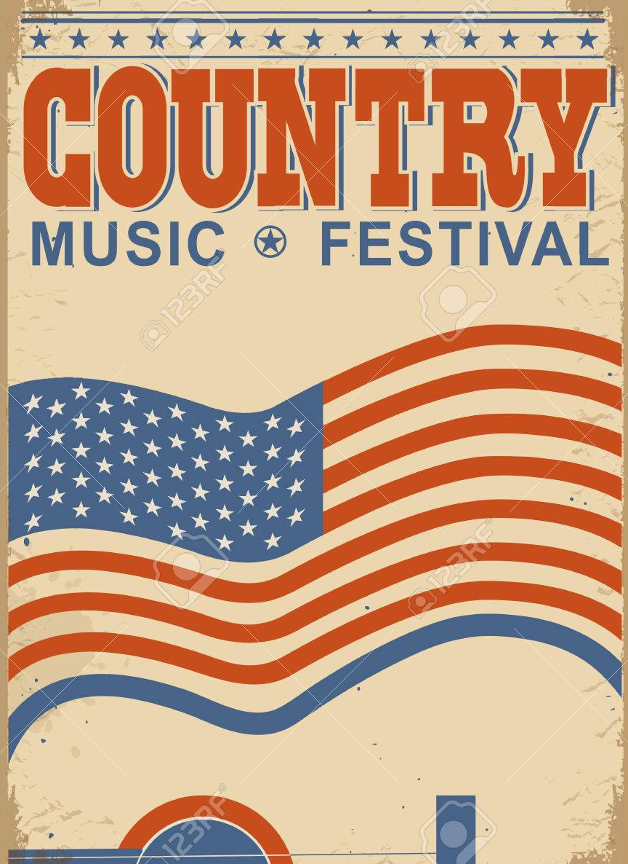
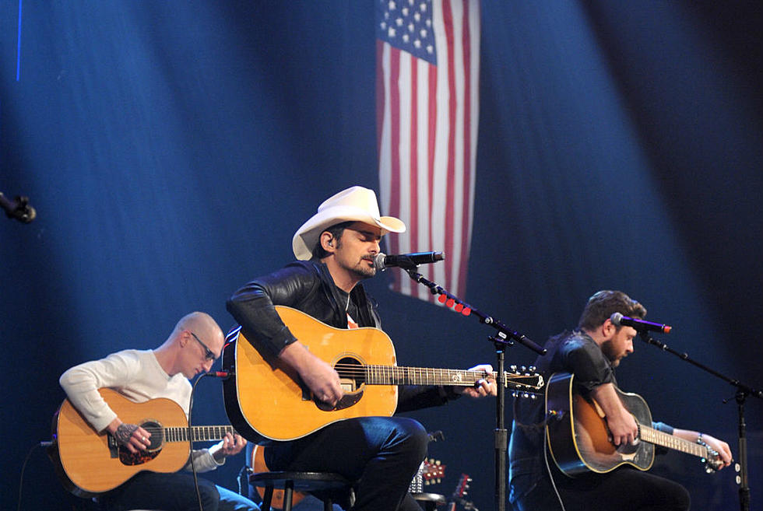
Patriotism

Slide 5
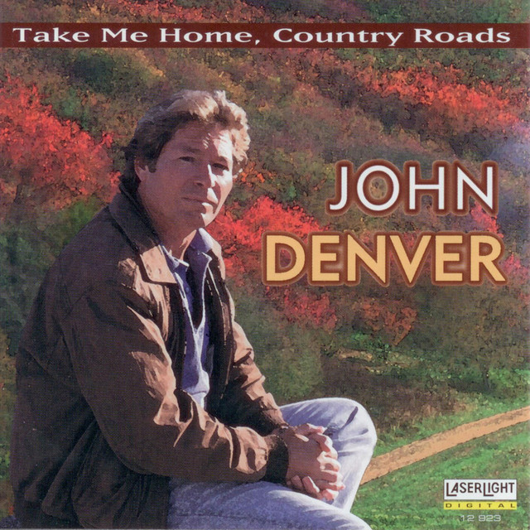
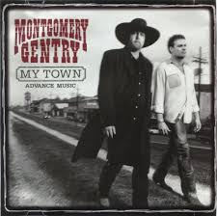
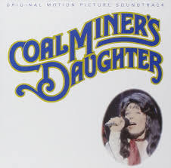
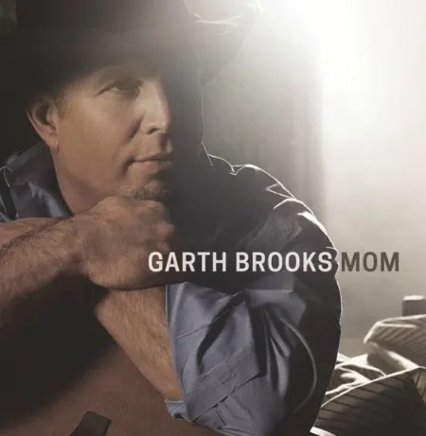
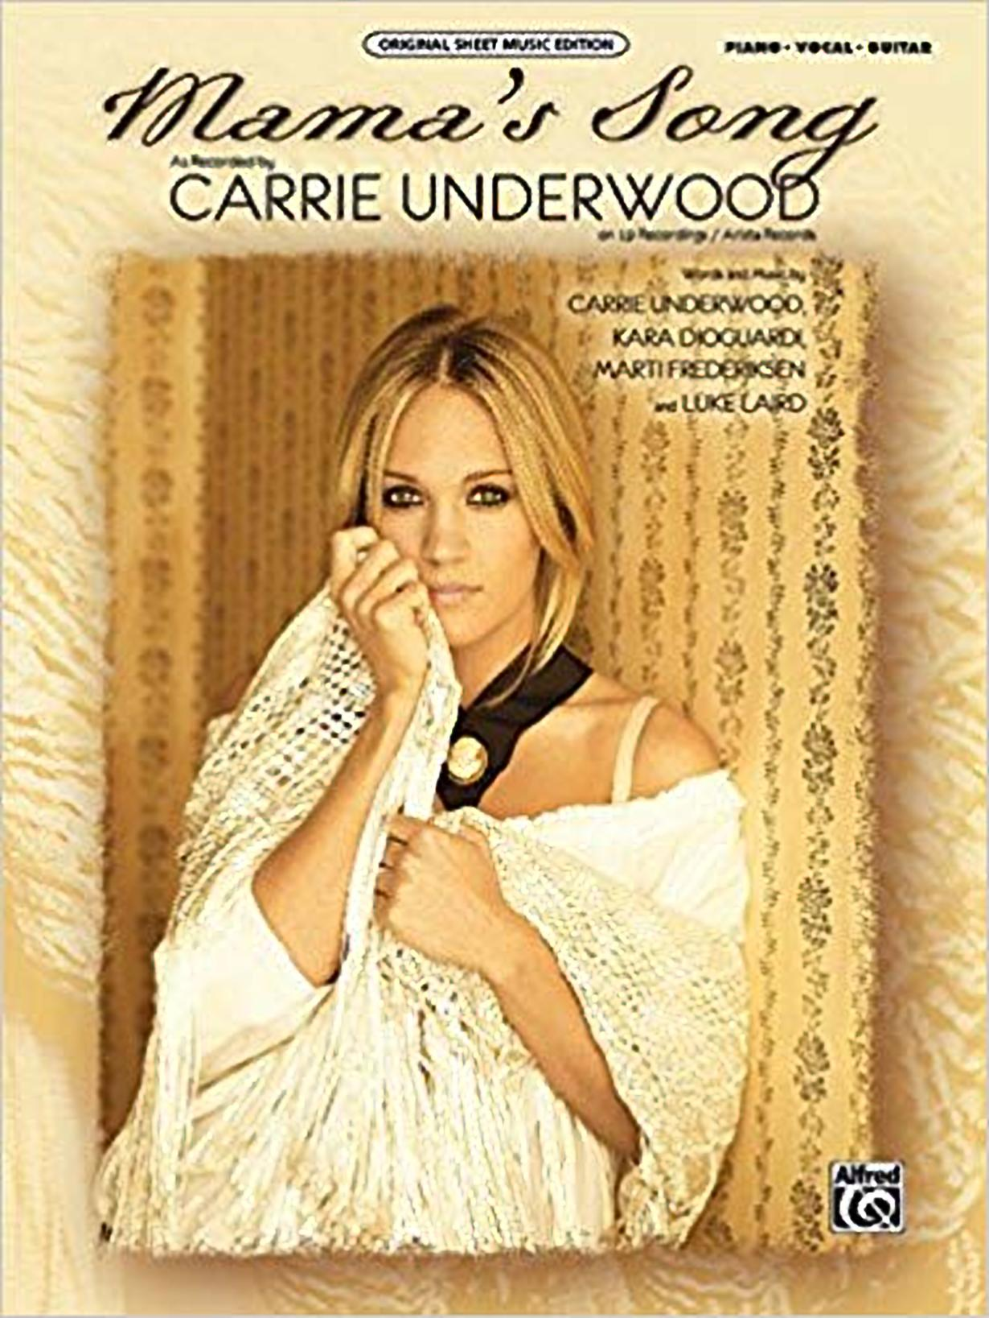
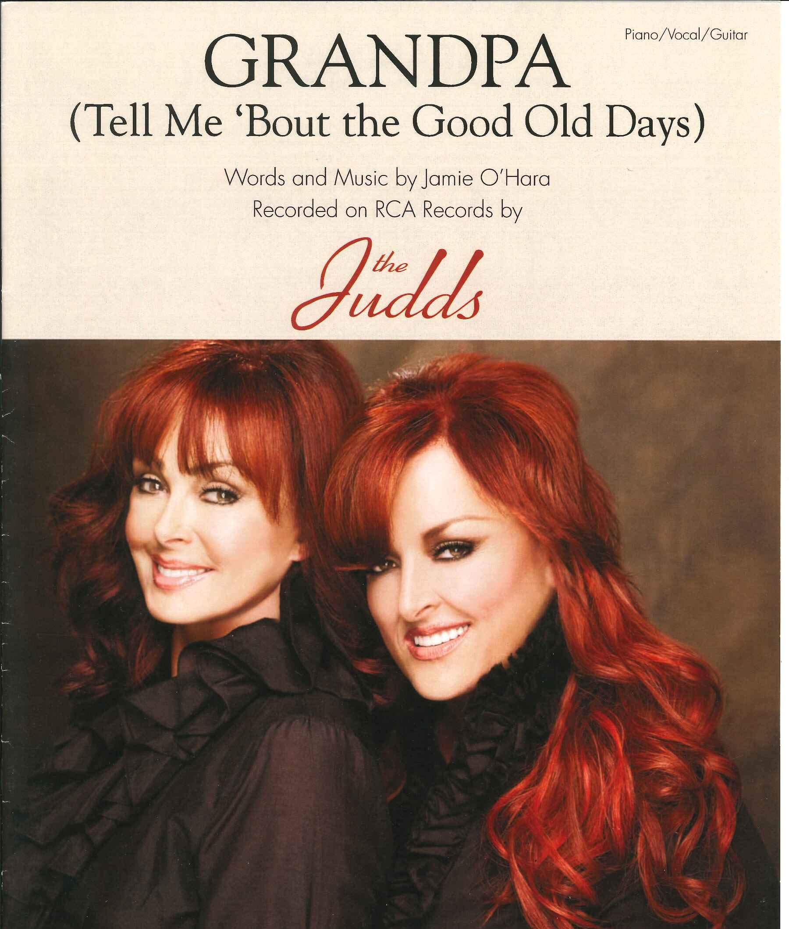
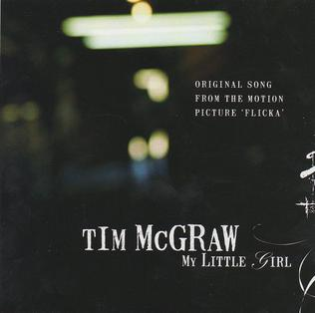
Home and family

Slide 6
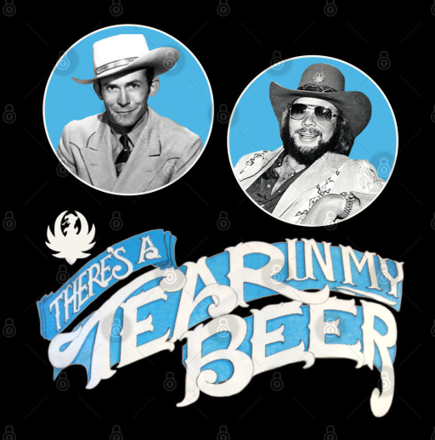
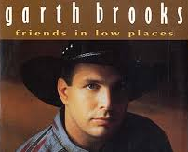
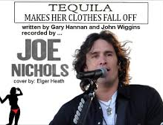
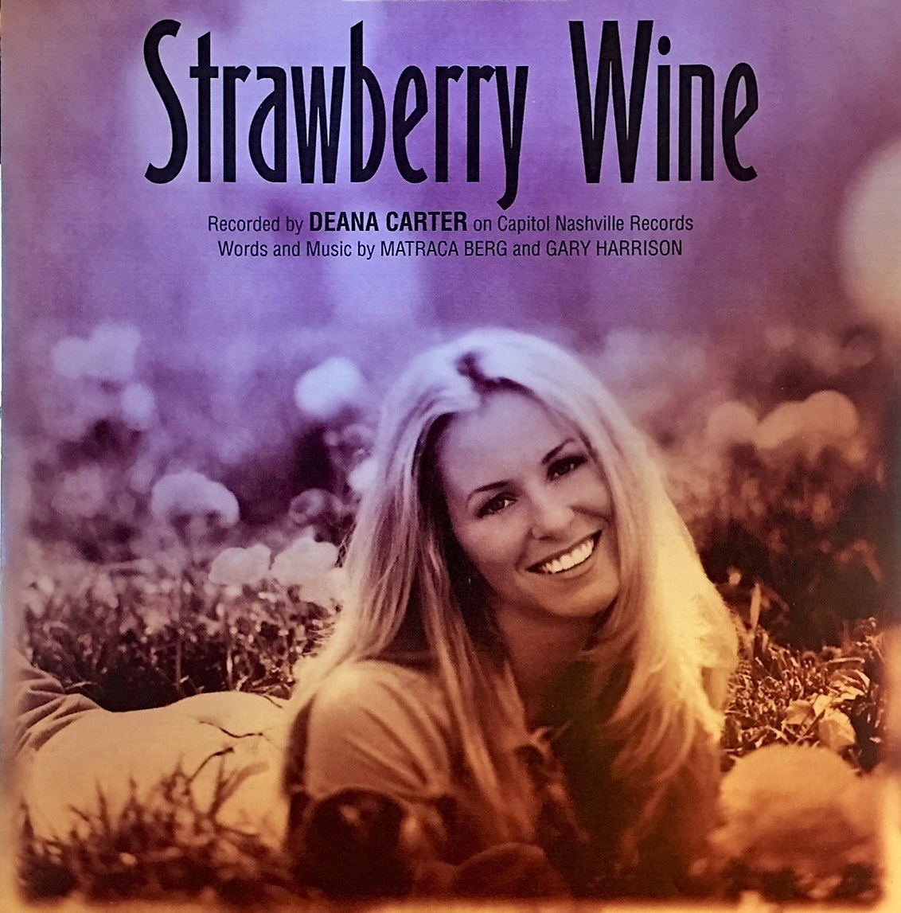
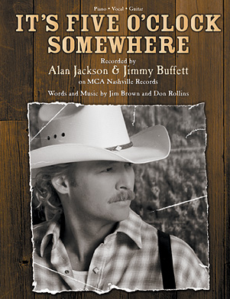
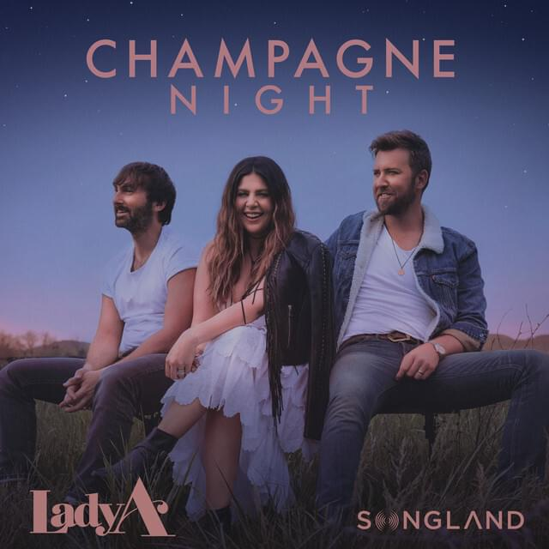
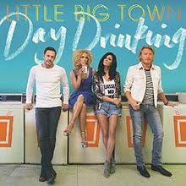
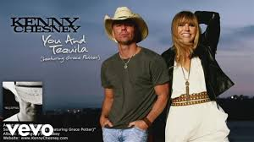
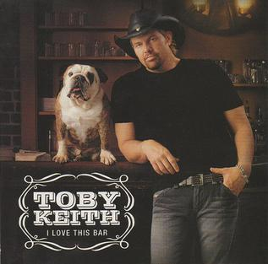
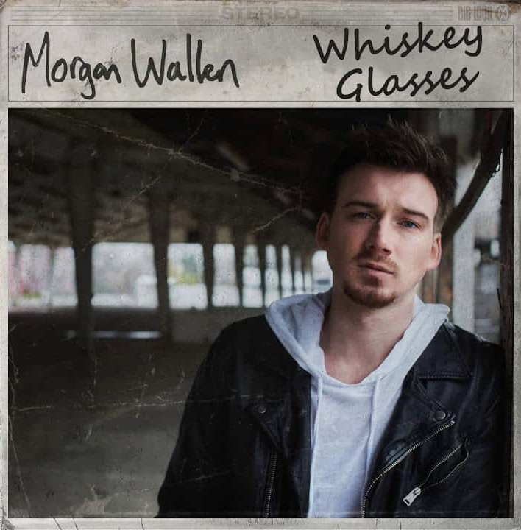
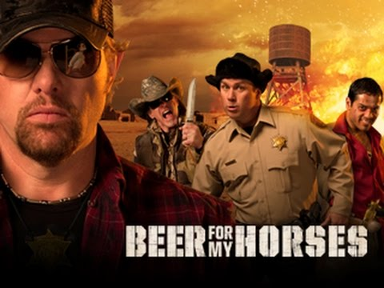
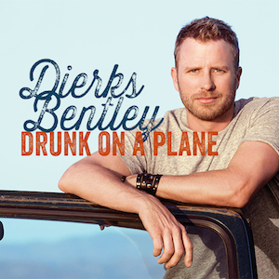
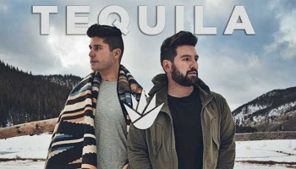
Alcohol use and abuse

Slide 7
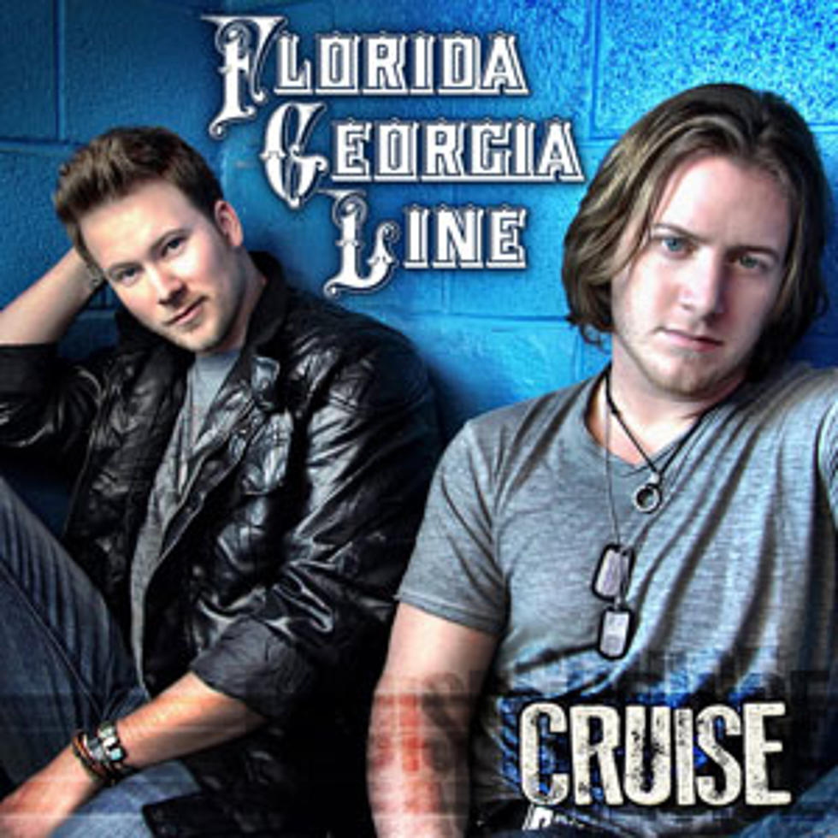
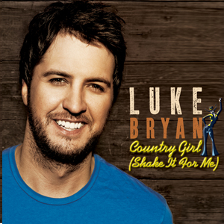
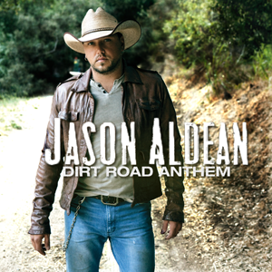
“Bro Country” Subgenre
Taking off in the 2010s, songs about attractive young women, the consumption of alcohol, partying, and pick-up trucks. Often with hip-hop or hard rock influence.

Slide 8
I’m Still a Guy- Brad Paisley
When you see a deer you see Bambi. And I see antlers up on the wall When you see a lake you think picnic, and I see a large mouth up under that log You're probably thinking that you're going to change me. In some ways well maybe you might Scrub me down, dress me up all but no matter what: Remember I'm still a guy
When you see a priceless French painting, I see drunk, naked girls You think that riding a wild bull sounds crazy, and I'd like to give it a whirl Well love makes a man do some things he ain't proud of, and in a weak moment I might Walk your sissy dog, hold your purse at the mall, but remember, I'm still a guy
I'll pour out my heart, hold your hand in the car, write a love song that makes you cry Then turn right around knock some jerk to the ground cause he copped a feel as you walked by
I can hear you now talking to your friends saying “Yeah girls he’s come a long way” From dragging his knuckles and carrying a club and building a fire in a cave. But when you say a backrub means only a backrub, then you swat my hand when I try Well, now, what can I say at the end of the day honey, I'm still a guy
These days there's dudes getting facials manicured, waxed and botoxed With deep spray-on tans and creamy lotiony hands, you can't grip a tacklebox With all of these men lining up to get neutered, it's hip now to be feminized I don't highlight my hair I've still got a pair, Yeah honey, I'm still a guy

Slide 9
Feminist Perspective
Beer, whiskey, tequila (not wine, wine-coolers, fruity drinks) serve as an identity marker of masculinity for men.
Supporting this music genre, which celebrates the use and abuse of these forms of alcohol, is a way to demonstrate masculinity - even if the listener does not drink alcohol.
Men can drink until incapacitated, thus leaving women to take care of the home.
Despite being 51% of the U.S. population, female country artists represent 13%-15% of music played on country radio. To get their music heard, female country artists are under pressure to write songs about alcohol.

Slide 11
Previous Research
Country music is significantly more likely to reference substance abuse than pop, rock, or R&B music, though less than rap (Primack et al. 2008; Seigel et al. 2013).
About 1/5 of the lyrical content of the songs referred to alcohol when referencing women (Lin and Rasmussen 2018)

Slide 12
Research Methods
Content Analysis
Country music billboard top 20 songs from 1944-2019

Slide 14
Average Number of Alcohol References, by Decade

Slide 15
Gender
Higher percentage of male artists referenced alcohol than female artists
Female artists more likely to reference alcohol to lyrically stage a scene, rather than celebrate inebriation

Slide 16
Average Number of Tobacco References, by Decade

Slide 17
Country Music’s long relationship with alcohol
Thomas R. Hochschild JR.
Lorna Alvarez-Rivera
Ellis Logan
Valdosta State University

