Slide 1
TRANSFORMATIVE LEARNING
APPLYING THEORY AND PRACTICE
Dr. Brittany L. Strickland
East Georgia State College
October 25, 2019

Slide 2
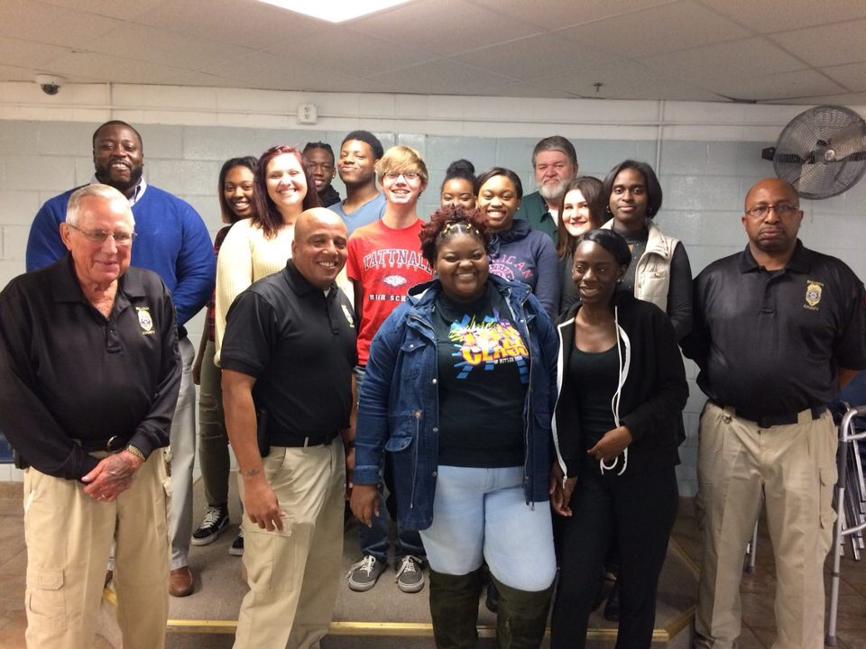
Purpose of Research
To encourage instructors to utilize trips and tours as an instructional resource
To create challenging environments for students
To make learning engaging
Unlearn or release old ways of thinking

Slide 3
Overview
Introduction to transformative learning
Outcomes of transformative learning
Trends in transformative learning
Exercise

Slide 4
Overview of Transformative learning
Jack Mezirow developed Transformative Learning Theory in 1978.
Occurs within environments that are both supportive and challenging. The environment needs to be supportive in that each learner needs to be considered valuable and unique.
Effectiveness for boosting learner autonomy and helping learners change how they approach their studies.

Slide 5
Outcomes of Transformative learning
Enhanced self-awareness and engagement in learning.
Allows the learners to come up with new beliefs, assumptions, and values (Morris & Faulk, 2012).
Strengthens student and instructor relationships.
For the instructor it heightens states of consciousness or awareness, insight, clarity and inner calm among the teachers.

Slide 6
Examples of Transformative Learning
Group discussion
Personal self-reflection
Critical reflection
Mentoring
Reflective discourse involves examining arguments, evidence, and alternatives through discussion.

Slide 7
Trends in Transformative learning
Videos
Modeling
Coaching
Simulations
Field trips
Journals

Slide 8
Exercise
List examples of trips/tours…
Be specific, and feel free to list other ideas!

Slide 10
Conclusion
The fundamental goal while considering adult education is that learners should be able to make their own interpretations instead of simply parroting others’ feelings, beliefs, judgments, and purposes.
Food for thought???

Slide 11
Resources
Morris, A. H., & Faulk, D. R. (2012). Transformative learning in nursing: A guide for nurse educators. New York, NY: Springer.

Slide 12
Comments

