Slide 1
Technology in the Classroom Engaging Students and Maintaining User Friendly Policies
Michael B. Shapiro, J.D. Department of Criminal Justice and Criminology, Georgia State University

Slide 2
Welcome! Before We Begin… Create and/or log in to your iClicker Reef Student account.
Download the iClicker Reef iOS or Android app from the iTunes or Google Play stores (or go to iClicker.com to participate using your computer).
Select Sign up. (If you are using a web browser select Sign In > Instructor > Sign Up.)
Select your institution. (If your institution is not listed, select Georgia State University as your institution.)
Enter your new account credentials, create a password, and click Create Account
Sign In to iClicker Reef as a student using your instructor credentials. (No need to register an iClicker remote.)
Select the + button to add course. Type Reef University as your institution and Parker Demo Course as your course.
Select Save.
Select your course and join the session when it becomes active.

Slide 3
The Dilemma
Our students are using technology everywhere in their lives
82% of Generation Y is connected wirelessly.
Do we, as faculty, attempt to prevent their use of technology in the classroom, or do we find a way to incorporate it into our lesson plans?

Slide 4
Our Use of Technology
We, and our students, are already using technology for class purposes:
PowerPoint lectures
ScanTron testing
Internet searches
Our students are “connected” 24/7. Should we expect them to disengage for our classes?

Slide 5
Issues with Technology – 1
Students use digital devices for non-class purposes more than 11 times on average (McCoy, 2016).
Students spend an average of 20.9% of class time using a digital device for non-class purposes (McCoy, 2016).
92% of college students reported using their phones to send text messages during class (Tindell & Bohlander, 2011).
Notes:
Most common – 86% said texting, 79% checked the time, 68% checked email, 66% social networking, 38% websurfing, 8% playing games, and 4% other

Slide 6
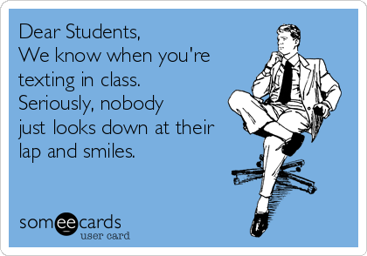

Slide 7
Issues with Technology – 2
30% of instructors have no policy regarding use of digital devices, but most students indicated that they thought instructors should have one (McCoy, 2013).
Research shows that students who actively text during class do worse on quizzes specifically designed to measure content about that class (Froese, 2012).
Notes:
Most common – 86% said texting, 79% checked the time, 68% checked email, 66% social networking, 38% websurfing, 8% playing games, and 4% other

Slide 8
Multitasking is a Myth
Younger people are more confident in their ability to multitask and do it more often.
But true multitasking is a myth.
Our brains focus on one thing by shutting out others and are not built for multitasking. (Gazzaley & Rosen, 2016).
We can’t pay attention to two things simultaneously.
Notes:
Most common – 86% said texting, 79% checked the time, 68% checked email, 66% social networking, 38% websurfing, 8% playing games, and 4% other

Slide 9
University Technology
Our schools are already using technology

Slide 10
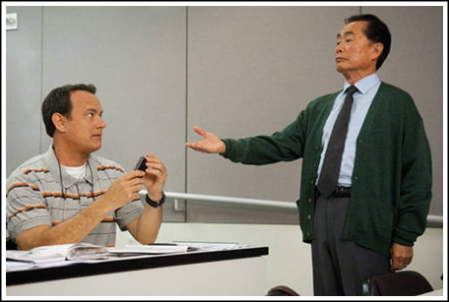
Technology Control Options
Require users to sit in the back.
Require users to sit in the front.
Require students who misuse technology to read the text on their device out loud.
Place devices on instructor’s desk.
Loss of points (individual or group).
Allow students to establish policy.

Slide 11
Technology Policy Considerations
Include policy in syllabus.
Require prior approval for usage.
Reasonable accommodations in cases of disability.
Get student “buy in”, discuss peer respect and potential for distraction of others, and that technology use in the classroom is a privilege, not a right.
Consider creating a “laptop-free” zone.
Designate “screen-down” times.
Make the technology tasks worthwhile to keep students on task, not simply busy-work.

Slide 12
Student Response Systems
Student Response Systems allow “polling” (real-time quizzing) of the audience. Some have proprietary systems, others provide “apps” for “smart phones”. Instant analysis and feedback.

Slide 13
Ways to Use a Classroom Response System
Taking attendance, including special events.
Gauging student preparation before the lecture to permit “on the fly” adjustment.
Gauging student comprehension during or after the lecture.
Review prior to quizzes or exams.
Administration of quizzes or exams.

Slide 14
iClicker Cloud Demonstration
Quick new class set up
New student download and registration
Question types:
Multiple choice
Numeric
Short Answer (with Word Cloud)
Targeted
Anonymous

Slide 15
Multiple Choice Questions
The capital of Georgia is:
A. Augusta
B. Athens
C. Atlanta
D. Attapulgus
True or False, this session has been educational:
A. True
B. False

Slide 16
Numeric Question
The square root of 100 is __________.

Slide 17
Short Answer Question
The most significant thing I have learned today is (limit 140 characters):
Short answers can be turned into word clouds

Slide 18
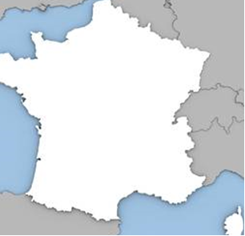
Targeted Questions
Locate Paris, France:
Find the verb:
Mike and Zoe lectured in Athens, Georgia.

Slide 19
Anonymous Mode
Version 4.6.2
Version 5.0.8
Yes or no, have you ever committed a crime? A = true B = false

Slide 20
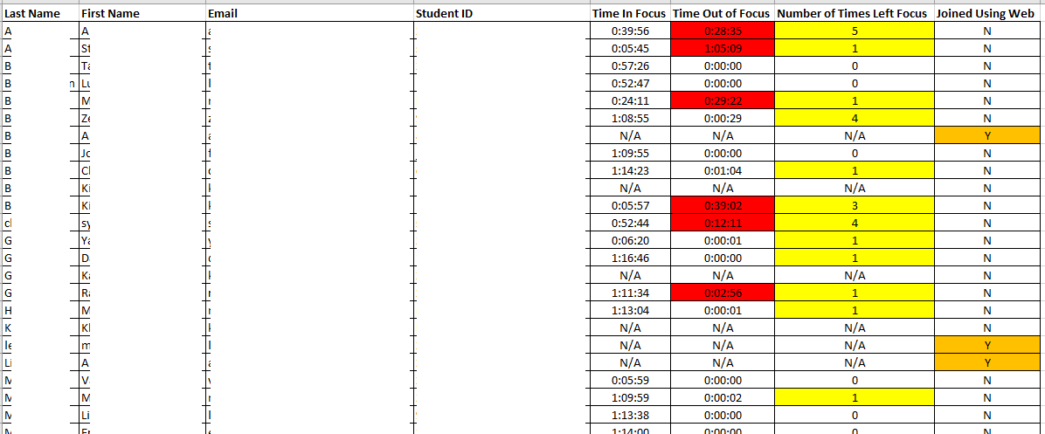
Focus Mode
iClicker has the ability to track students’ choice to leave the iClicker software (“guided access” or “focus mode”).
At the end of a session, iClicker emails the instructor with the number of instances and total time students spend outside of the program.

Slide 21
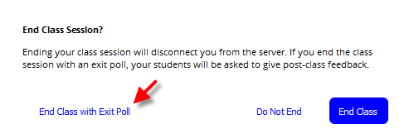
End of Class Poll

Slide 22
Questions?

Slide 23
Contact Information
Michael B. Shapiro Clinical Assistant Professor 404-413-1028 mshapiro5@gsu.edu
Glen Garrett Macmillan 615-598-3638 glen.garrett@macmillan.com

Slide 24
References
Froese, A., Carpenter, C., Inman, D., et al. (2012). Effects of Classroom Cell Phone Use on Expected and Actual Learning, College Student Journal, 46, pp. 323-332.
Gazzaley, A. & Rosen, L. (2016). The Distracted Mind. Cambridge, MA: MIT Press.
McCoy, B. (2013). Digital Distractions in the Classroom: Student Classroom Use of Digital Devices for Non-Class Related Purposes. Faculty Publications, College of Journalism & Mass Communications, 71.
McCoy, B. (2016). Digital Distractions in the Classroom Phase II: Student Classroom Use of Digital Devices for Non-Class Related Purposes. Faculty Publications, College of Journalism & Mass Communications, 90.
Tindell, D. & Bohlander, R. (2011). The Use and Abuse of Cell Phones and Text Messaging in the Classroom: A Survey of College Students. College Teaching, 60:1, 1-9.

Slide 25
Resources
Maximize the Impact of Student Response and Engagement Solutions in your Classroom (https://go.macmillanlearning.com/Recording-180914-Maximize-the-Impact-of-Student-Response-and-Engagement.html)
Designed with Outcomes in Mind: iClicker and Learning Science (https://community.macmillan.com/videos/2312-iclicker-and-learning-science)
Assessment Strategies for Deeper Learning (https://learn.iclicker.com/190123-Assessment-Strategies-For-Deeper-Learning.html)
Dancing Through Change: How to Navigate a New Student Response Implementation (https://learn.iclicker.com/ic-recording-181101-Dancing-Through-Change-How-To-Navigate-A-New-Student-Response-Implementation.html)

Slide 26
Resources
Using iClicker in Small Classes (https://learn.iclicker.com/190208-Using-iClicker-in-Small-Classes.html)
Closing the Loop: Using iClicker & LaunchPad for Success In & Out of Class (https://learn.iclicker.com/190301-Closing-the-Loop-Using-iClicker-and-LaunchPad-for-Success-In-and-Out-of-Class.html)
Building a Game-Based Learning Experience in the Classroom with iClicker (https://learn.iclicker.com/190305-Building-Game-Based-Learning-Experience-in-the-Classroom-with-iClicker.html)

