Slide 1
Inmate Characteristics and Factors Associated with Sentencing
By: Stu Batchelder
University of North Georgia

Slide 2
Overview
The evolution of sentencing policy and reform
Attitude and Impact

Slide 3
The choice: incarcerate or Probation
Probation Community service -- Treatment-oriented programs
Intermediate sanctions
Prison -- Incarceration

Slide 4
Abraham Maslow
"If all you have is a hammer, everything looks like a nail”
“If you spend billions on prisons, every offender belongs in a cell”

Slide 5
Approach 1960’s -1970’s
Reduce:
1) Sentencing disparity
2) Arbitrary sentencing
3) Racial discrimination and fairness

Slide 6
Criticism -- 1980’s
Sentence at 15 years
Incarceration is only two years

Slide 7
Criticism -- 1980’s
Martinson Report
“What works” became “Nothing works”
Truth-in-sentencing
Mandatory minimum sentences
Martinson Report -- Nothing works

Slide 8
Get-tough Approach 1990’s
From: Discretionary release (parole)
To: Restrictive “fixed” sentences
Even to abolish parole

Slide 9
Get-tough Approach 1990’s
1999: 29 states 85% of sentence

Slide 10
Summary of the 1980 - 2000 Trend
1980 – 2000 Prison growth--non-violent drug offenders
58% Prison pop: drug offenders -- no history of violence.

Slide 11
1980 - 2000 Trend
Why would we want to fill our prisons with non-violent and non-serious offenders?

Slide 12
2001 – Trend REversal
States repealed truth-in-sentencing for non-violent offenders
Parole elegibility after serving 25%

Slide 13
2009-2015 Trend
1) 5% reduction in the overall prison population
2) ½ prison population = violent offense: assault and robbery

Slide 14
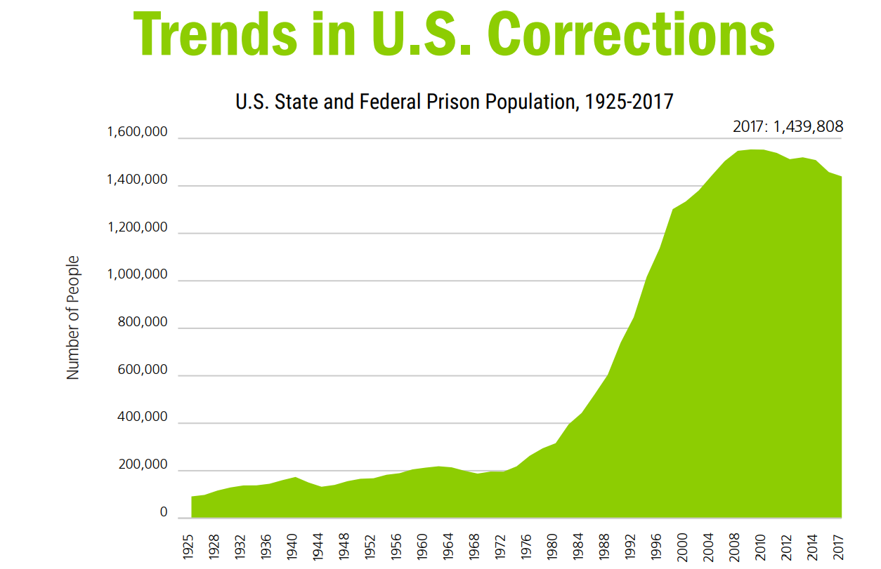

Slide 15
Sentencing Factors
Changing Trends in Sentencing
1) Age
2) Race
3) Gender

Slide 16
Age -- Life Sentences
Life With Possibility of Parole
Originally: A shorter sentence
1) Age-out past 50
2) Improve Public Safety
3) Better uses of public resources

Slide 17
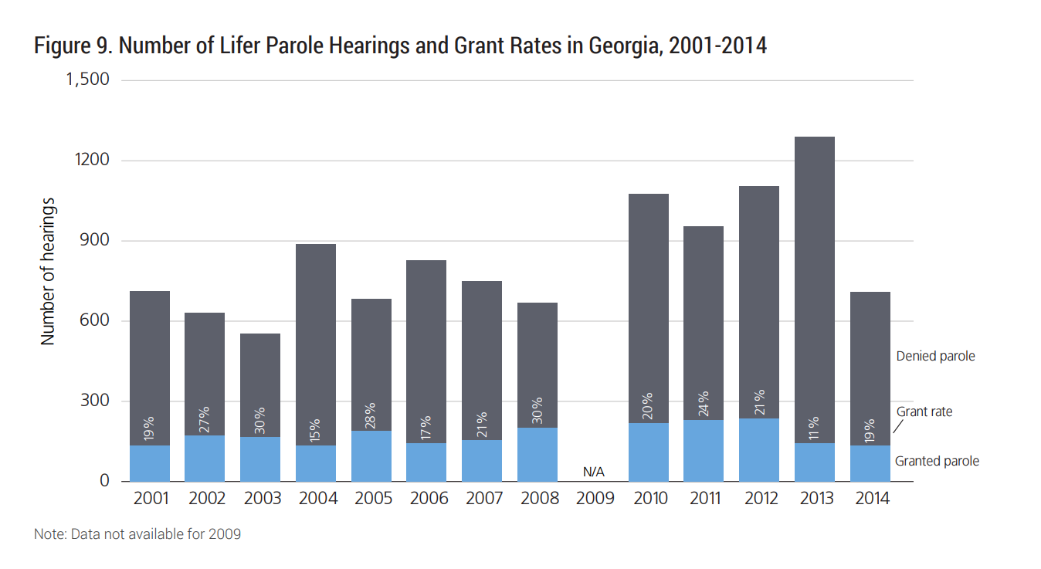
Life Sentences -- Parole Eligible Inmates

Slide 18
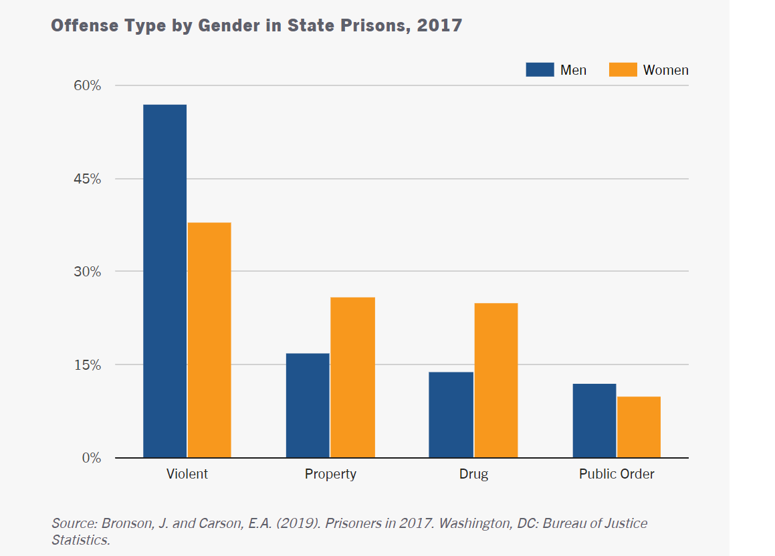
Women

Slide 19
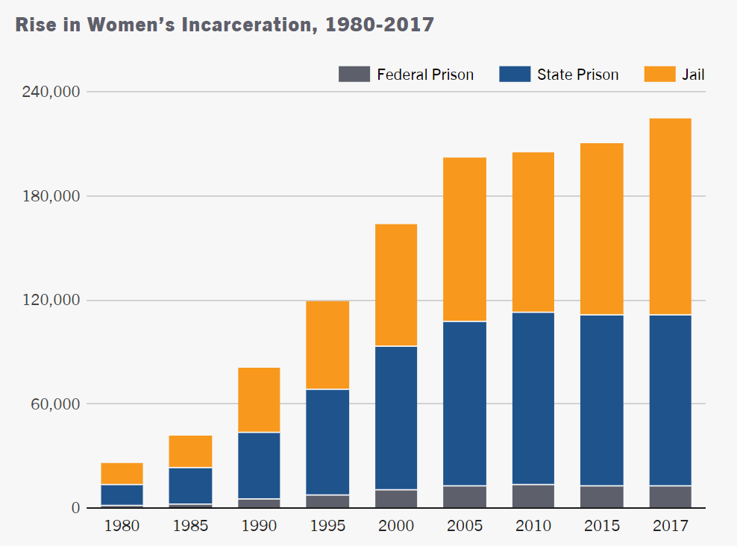
Women

Slide 20
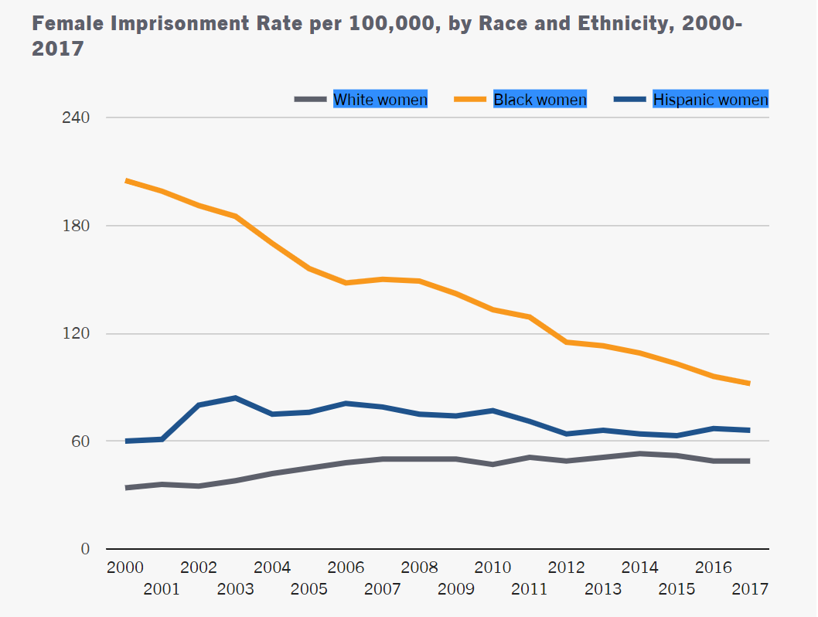
Women

Slide 21
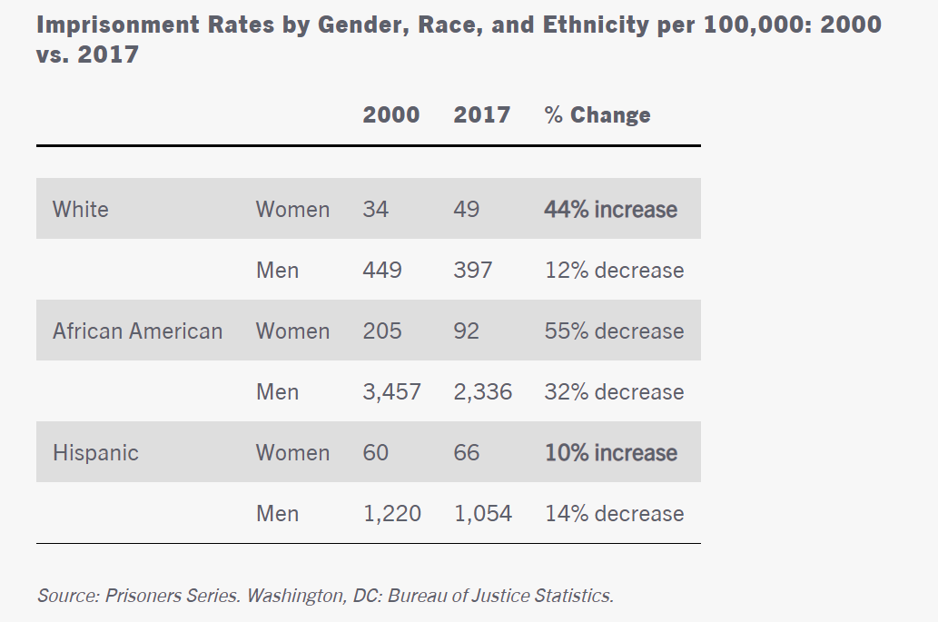
Gender by Race

Slide 22
2018 - First Step Act
1) Applied to: Imprisoned for drug crimes
2) Gives judges sentencing latitude
3) Earn increased good-time
4) Recidivism reduction programming
5) Credits for participation
Residential reentry centers

Slide 23
2019 -- Second Look Act
Sentence reduction after 10 Yr
Eligibility
1) Not a danger to safety
2) Demonstrated readiness for re-entry
3) Interests of justice warrant sentence modification
½ Federal prison population are eligible to apply

Slide 24
Long sentences deter future crimes? No
1) Getting caught
2) Not familiar with penalties
3) Judgment compromised
4) Impede investments in crime prevention

