Slide 1
Integrating POST Content into Academic Courses: An Assessment of UNG’s Public Safety Academy
Timothy C. Hayes, Butch Newkirk, and Sallie Parker
Department of Criminal Justice
University of North Georgia

Slide 2
Things to Cover
Why we established the Public Safety Academy
How we integrated POST content
Integrating POST into our assessment efforts
Initial Results
What’s next
Conclusions / Wrap-up

Slide 3
Background on UNG Public Safety Academy
Feedback from students and alumni
Big question: Why can’t we get the training we get at the academy while we are working on our degree at UNG?
Feedback from Internship supervisors
Most indicated they would outright hire our graduates as long as they could get their POST training done. But less and less agencies are paying for it
Began working on a proposal to POST and to UNG around 2014

Slide 4
POST content + Academic courses
Matched POST PORT content with existing courses in our curriculum
Created labs for PORTS that did not match, plus a few new courses
Public Safety Academy Students register for labs alongside specific academic courses.
Academy Students take PORT exams as they complete content in specific courses

Slide 5
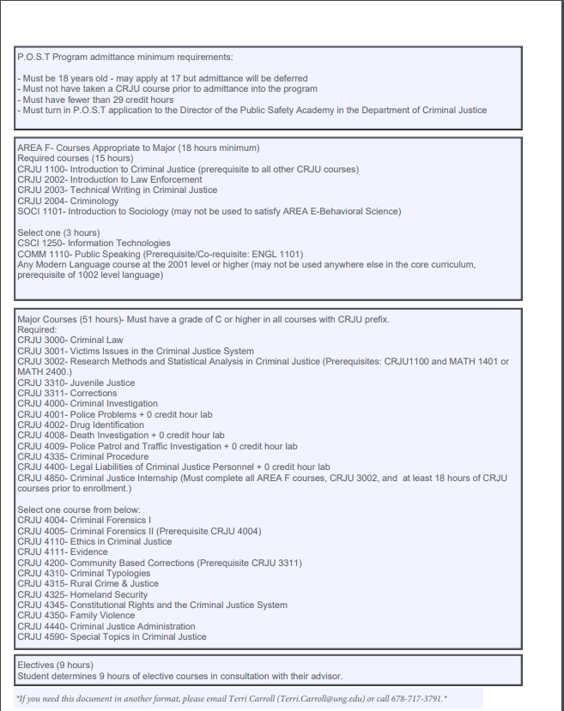

Slide 6
PORTS matched with existing courses
COURSE | Associated PORTS
CRJU 1100: Intro to CJ | 1.1, 1.3
CRJU 2002: Intro to Law Enforcement | 3.7, 4.1, 4.8, 4.11, 4.7.7, 4.12
CRJU 2003: Tech Writing | 3.1, 4.9
CRJU 3000: Criminal Law | 2.1
CRJU 3001: Victims Issues | 5.7, 3.6, 3.9
CRJU 3310: Juvenile Justice | 5.8
CJRU 4000: Criminal Investigations | 5.3,5.5,5.6,5.11,5.12,5.13,7.1
CRJU 4001: Police Problems | 4.6

Slide 7
PORTS matched with existing courses (contd)
COURSE | Associated PORTS
CRJU 4002: Drug ID and Investigation | 5.14
CRJU 4008: Death Investigation | 5.2, 5.15, 7.8
CJRU 4009: Police Patrol and Investigation | 6.1,6.2,6.3,6.4,6.5,6.6
CRJU 4335: Criminal Procedure | 2.2
CRJU 4400: Legal Liabilities | 1.2, 2.4, 7.9, 7.10
Lab – EVOC | 7.5
Lab – Vehicle Pullovers | 4.4
Lab – Firearms | 7.2
Lab – Control Tactics | 7.3
Lab – First Aid and CPR | 7.4

Slide 8
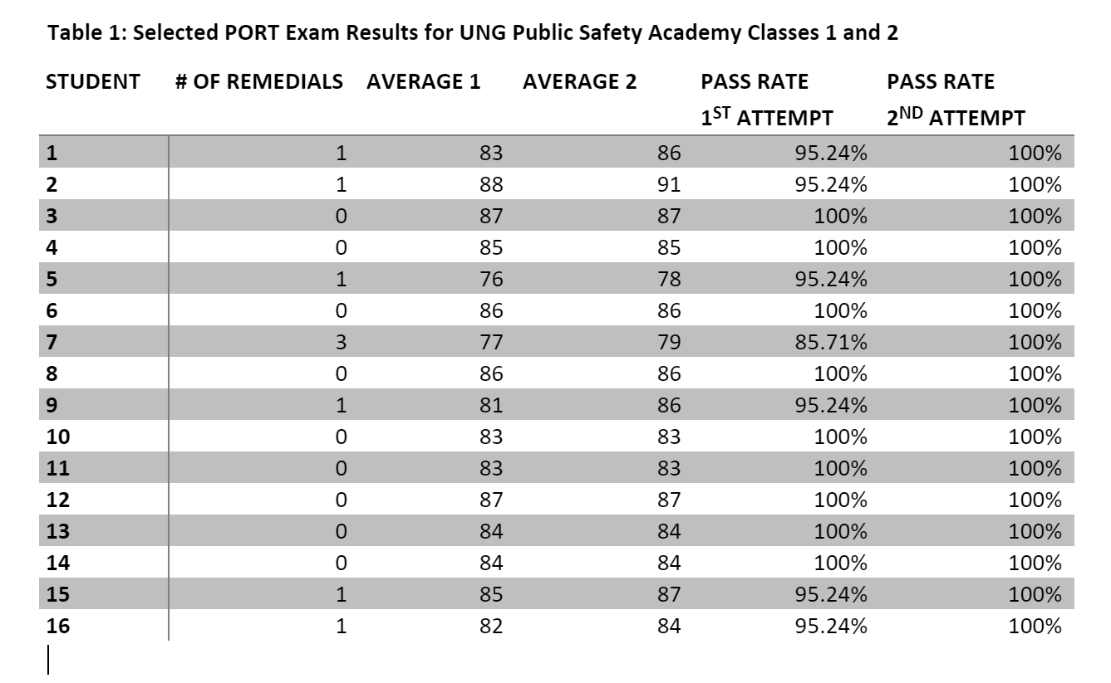
PORT Exam Results for Class 1

Slide 9
What’s Next?
Follow up with Class graduates and agencies 6 months to 1 year from graduation
Interview FTO to get feedback
Examine use of force incidents and how our graduates perform

