Slide 1
Georgia’s New DUI Law
CJAG Conference
October 2019
Pamela Newell
University of North Georgia

Slide 2
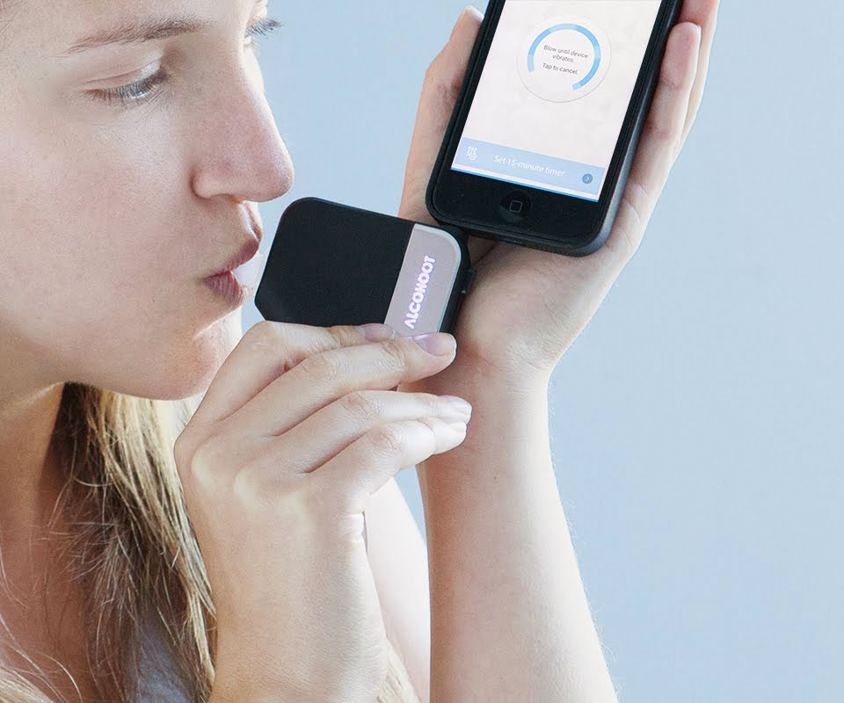
New Georgia DUI Law: The Elliott Case

Slide 3
Introduction
New holdings (from Olevik and Elliott) impact the implied consent notice to search that Georgia has had on its books for decades.

Slide 4
Georgia Implied Consent Notice
Georgia law requires you to submit to state administered chemical tests of your blood, breath, urine, or other bodily substances for the purpose of determining if you are under the influence of alcohol or drugs. If you refuse this testing, your Georgia driver's license or privilege to drive on the highways of this state will be suspended for a minimum period of one year. Your refusal to submit to the required testing may be offered into evidence against you at trial. If you submit to testing and the results indicate an alcohol concentration of 0.08 grams or more, your Georgia driver's license or privilege to drive on the highways of this state may be suspended for a minimum period of one year. After first submitting to the required state tests, you are entitled to additional chemical tests of your blood, breath, urine, or other bodily substances at your own expense and from qualified personnel of your own choosing. Will you submit to the state administered chemical tests of your (designate which tests) under the implied consent law?

Slide 5
Previous Case: Olevik
Previously, the Georgia courts have held that the Fifth Amendment to the U.S. Constitution did not give defendants a right to refuse a lawful breathalyzer request, blood draws, and bullet removals.
In Olevik, the Georgia Supreme Court held that the Georgia Constitution had broader protections against a suspect than the Fifth Amendment to the U.S. Constitution. The Olevik Court stated that the “Georgia Constitution’s right against compelled self-incrimination prevents the State from forcing someone to submit to a chemical breath test.”

Slide 6
ISSUES
Paragraph XVI of the Georgia Constitution:
“Self-incrimination. No person shall be compelled to give testimony tending in any manner to be self-incriminating.”
The issues in Elliott were:
(1) whether “testimony” is limited to oral or written evidence; and
(2) whether admitting evidence of the refusal to undergo a chemical test was a violation of the GA Constitution.
The Elliott case definitively held that “testimony” included affirmative acts, such as blowing into a breath chemical analyzer.

Slide 7
State v. Elliott, 824 S.E.2d 265 (2019)
Facts: Df refused to submit to a breathalyzer test after being pulled over for suspected driving under the influence. Law enforcement arrested her. The prosecution used evidence of her failure to take the chemical breath test against her in court. Prior to trial, Df filed a motion to suppress the evidence of her refusal. The trial court denied her motion and she appealed the ruling.
Under Georgia’s previous statute, the state could use evidence of her refusal against her in a criminal trial for DUI. The Elliott Court held that the Georgia Constitution affords Df more rights against compelled self-incrimination
Accordingly, the Court invalidated portions of the Georgia Implied Consent Notice

Slide 8
Elliott Analysis
The Elliott Court began its analysis by looking at the principles of the Georgia Constitution. The legislature passed the latest Georgia Constitution in 1983. Noting this, the court stated that, “[a] constitutional clause that is readopted into a new constitution and that has received a consistent and definitive construction is presumed to carry the same meaning as that consistent construction.”

Slide 9
After this discussion, the court went on to explain how there is a common law right against compelled self-incrimination, beginning with England’s common law. The court went on to note that the right against self-incrimination has always covered more than just oral testimony.
The court held that “testimony” covered affirmative acts that tended to “furnish evidence.”
This follows the U.S. Supreme Court’s interpretation of the Fifth Amendment. It also follows many other states’ laws, including Alabama, North Carolina, Tennessee, Iowa, Texas, Utah, Oklahoma, and Michigan.
Throughout the Elliott opinion, the court continued to return to the reasoning and holding of Olevik, which showed a “consistent and definite construction” of Paragraph XVI of the Georgia Constitution under previous cases.

Slide 10
The next issue was whether admitting the fact that the defendant refused the chemical test was also a violation of Paragraph XVI. The Elliott Court held that the U.S. Supreme Court’s holding in Griffin v. California, 380 U.S. 609 (1965) did not apply. Griffin held that prosecutors were barred from commenting on a defendant’s failure to testify.
The court admitted that its holdings were not always consistent with Miranda v. Arizona
The court stated that Elliott made it so the Fifth Amendment, the GA Constitution, and US Supreme Court’s holdings were now properly aligned.
The right to refuse to submit to the chemical test under Paragraph XVI, and the trial court admission of the refusal violated the Georgia Constitution.

Slide 11
New Statute
As a result of Elliott, the implied consent statute has not been fully overruled. It just does not apply to chemical breathalyzer tests.
Elliott did not address blood tests or administrative proceedings.
The Georgia Implied Consent Notice will have to be amended.

Slide 12
Raise new issues?
What should Georgia police officers do once they pull over a suspected impaired driver?
The court will now have to determine if a suspect voluntarily submitted to a test and how that evidence can be used at trial.
Law enforcement will now have to be prepared to seek warrants for blood or urine tests when they did not need them before.
These tests must be administered at a medical facility. This could be a phenomenal change, especially for those pulled over in rural areas.

