Slide 1
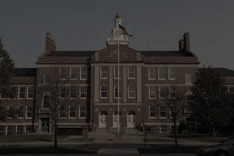
K-12 Alma Mater School Shootings with >2 Killed, 1990-2018
Thomas R. Hochschild Jr.
Lorna Alvarez-Rivera
Michael Noll
Valdosta State University
Kathryn Grant
Campaign to Keep Guns Off Campus

Slide 2
Mass Shooting
Rampage Shooting
Why >?
Spree Shooting
Serial Shootings

Slide 3
No Naming Approach
No Notoriety (https://nonotoriety.com)
Don’t Name Them (www.dontnamethem.org)

Slide 4
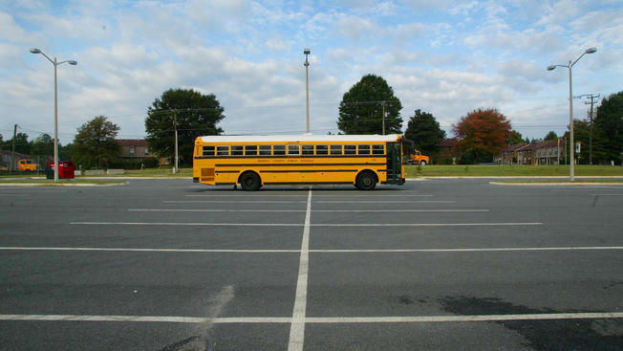
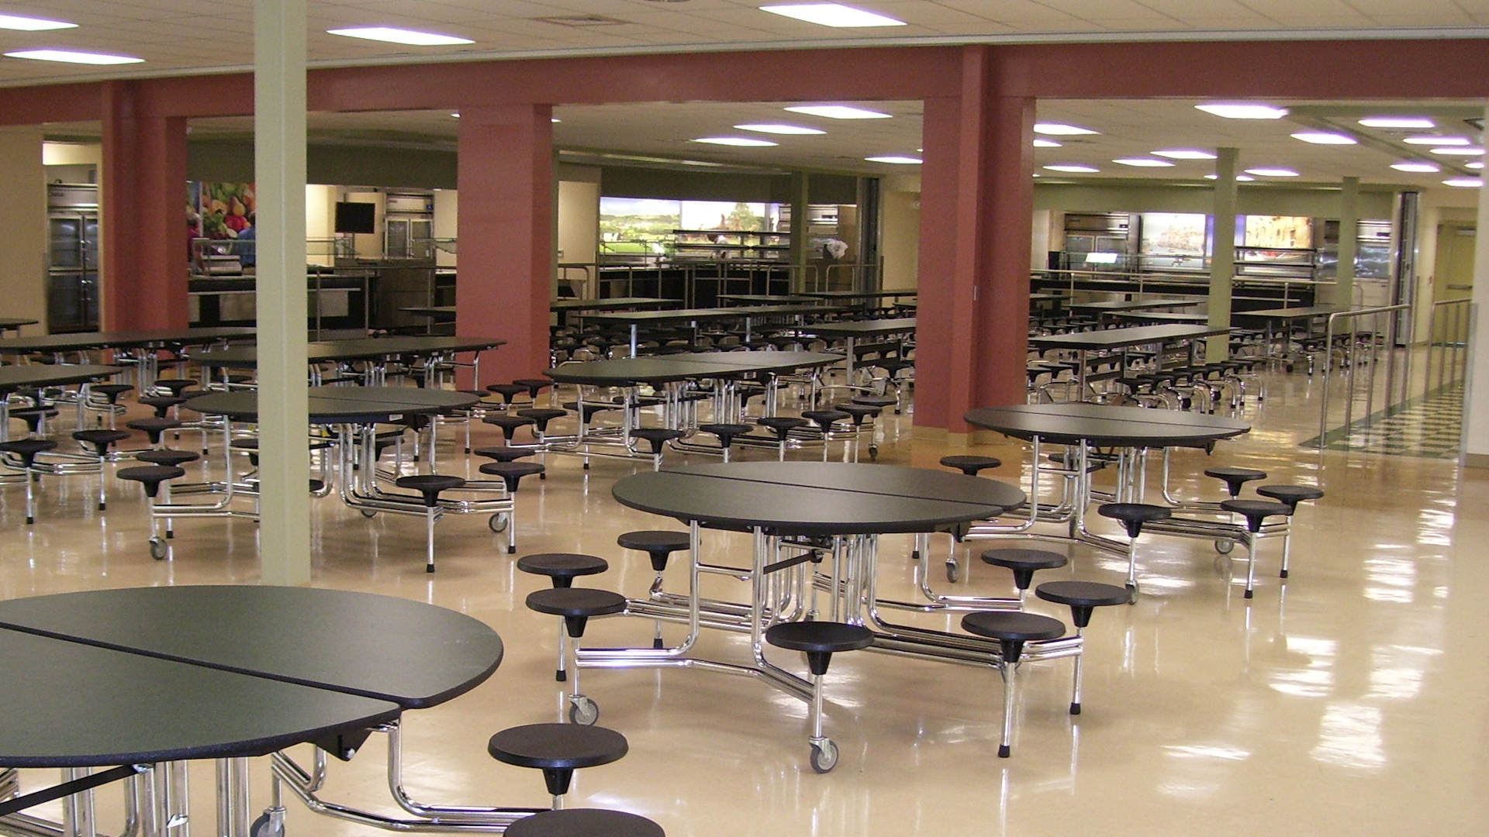
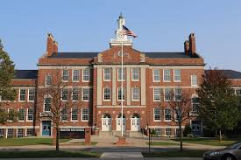
Why do shooters go back to their alma mater?
Place Trauma: Emotional pain associated with a location.

Slide 5
Demographic Characteristics
All Males
20 White & 3 Native American

Slide 6
Shooters’ Personal Troubles
Poor Academic Performance
Physical and Mental Abuse
Mental Health Issues
Violent Thoughts

Slide 7
Spatiotemporal Characteristics
10 out of 23 in the South:
Texas, Oklahoma, Arkansas, Louisiana, Mississippi, Alabama, Georgia, Florida, South Carolina, North Carolina, Tennessee, Kentucky, West Virginia, Virginia, Maryland, and Delaware.

Slide 8
Spatiotemporal Characteristics
10 out of 23 in the South
All public schools
13 out of 23 in February-May

Slide 9
Acquisition of Firearms
Two shooters acquired guns legally
Two shooters used firearms that were gifts
18 out of 23 stole the firearm of a family member

Slide 10
What Can We Do?
Healthy male socialization
Be on alert for “leakage” about potential violence
Increase access to mental health professionals
Anti-bullying programs: Olweus & Kiva
School hardening
Gun safety legislation

Slide 11
K-12 Alma Mater School Shootings with >2 Killed, 1990-2018
Thomas R. Hochschild Jr.
Lorna Alvarez-Rivera
Michael Noll
Valdosta State University
Kathryn Grant
Campaign to Keep Guns Off Campus

