Slide 1
THE USE OF FORCE AMONG POLICE OFFICERS Revisiting the regulations of interactions by the police
Capt. Jeffrey Smith, D. Sc.
Lawrenceville (GA) Police Department
Melchor C. de Guzman, Ph.D.
Georgia Gwinnett College
Criminal Justice Association of Georgia Annual Conference
Valdosta State University
Valdosta, GA
February 7-8, 2019

Slide 2
Background
The police use of force is varied and seem to follow a pattern (Sykes & Brent, 1980)
The police use of force are sometimes conditioned by police perception of the suspect as a symbolic assailant (Skonick, 1975)
The use of force is conditioned by suspect deference to authority (Klinger, 2005) and other factors (Pettersson, et al., 2012)

Slide 3
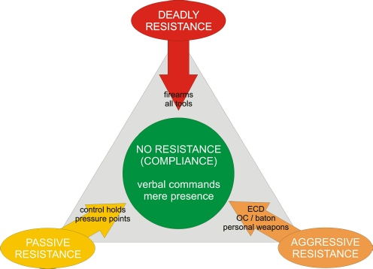
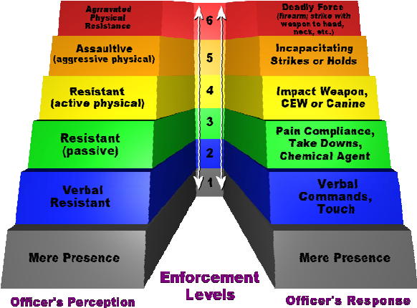
Approaches to Controlling the LE Use of Force
Law (Ex. Graham v Connor; Tennessee v Garner; Plakas v Drinski )
Administrative monitoring
Alternative non-lethal force
Use of Force Continuum or Dynamic Resistance Response Model (DRRM)
about 80% of department (Terrill, 2011)

Slide 4
Research Questions
How do police officers exercise the use of force?
How do police officers observe the use of force continuum?
What factors influence the use of force by the police?

Slide 5
Hypotheses
The use of force among police officers are correlated with the presence of threats (Symbolic Assailant Hypothesis)
Certain situational factors influence the use of force
Environmental factors
Suspect/Subject factors
Officer Factors

Slide 6
Methods

Slide 7
Samples
Use of force data from 2015-2017 (n=138)
Reports collected and filed for every incident on the use of force by the police officers

Slide 8
Measures
Use of force is an index measure that adds all all the reported force mechanisms used by the police
Dangerousness of suspect is a multiple items index measure that include demographic and suspect conditions and weapons during the encounter
Environmental conditions are items that pertain to nature of calls, number of persons at the scene, the number of officers in the scene, and the shift

Slide 9
Findings

Slide 10
Descriptive Statistics Officer Use of Force
(N= 138)

Slide 11
Use of Force in Love Enforcement City, 2010-2016

Slide 13
Descriptive Statistics Suspect/Subject Information
(N= 138)

Slide 15
Multiple Regression Model

Slide 17
Discussion
Findings are consistent with previous study that use of force seems to be rare and is exercised with restraint.
Use of deadly force in policing is rare in Love City
Data seem to support the symbolic assailant hypothesis
Caveat is that demographics were not significant predictors of the use of force although males and African Americans are overly represented in the sample.

Slide 18
Conclusion & Recommendation
The Love City Police Department maintains a conscious effort to avoid unnecessary use of force.
The study has added evidence to the claim that perceptions of danger are primary motivations for police use of force.
The study found partial support for demeanor as a predictor of the use of force as police officers significantly use greater force with threats from suspects/subjects.

