Slide 1
Operation Stonegarden Rural Law Enforcement Initiative for Human Trafficking, Drug Enforcement and Anti-Terrorism
Melchor C. de Guzman, Professor of Criminal Justice and Criminology
Georgia Gwinnett College
Gary Metz, Associate Professor of Health Care
The College at Brockport, State University of New York
Georgia Criminal Justice
October 14, 2016

Slide 2
Background
Police capacity development – improve or create the technical, personal, or organizational abilities of police agencies to effect desired change (Harris, 2005; Heyer, 2010)
Border security became a prime concern after 911 (de Guzman, 2002)
Local police agencies have switched to the Homeland Security Policing (HSP) mode (Kim and de Guzman, 2010)

Slide 3
Research Objective
Identify the capacity development approaches applied in the a rural (county) police environment.
Provide initial evidence of the effectiveness of Operation Stonegarden in terms of effecting organizational change, providing technical support, and other measures.

Slide 4
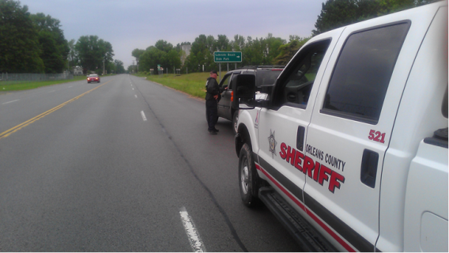
Operation Stonegarden
Funded by the Department of Homeland Security and administered by U. S Customs and Border Patrol.
To enhance law enforcement preparedness and operation readiness along the U.S. Borders.
Focus is on Northern Border of the United States
Orleans County
Lake Ontario
Niagara
Monroe

Slide 5
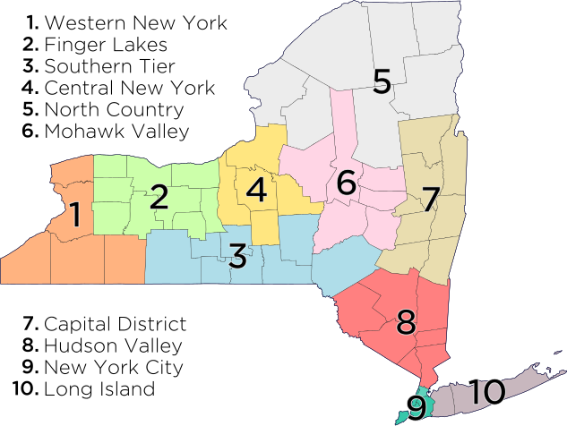
Map of Operation

Slide 6
Research Methods
Case study approach
Secondary data analysis
Examination of structural reforms to effect organizational change and effect capability self-concept (Bayley, 2006)
Outlining of collaborative efforts and technical assistance (Morgan, 1998)
Examination of the operational efficiency of the department

Slide 7
Pre v. Post Stonegarden
The sheriff’s office had one boat used for towing vessels that were broken down on the Lake Ontario. Not enough budget for personnel overtime deployment.
The Sheriff’s Office could only speculate what border specific problems could be occurring prior to Stonegarden. There was no coordinated plan of action to check incoming vessels prior to this grant. The Sheriff’s Office only assisted stranded vessels for the purpose of towing to shore.
The Sheriff’s Office employs one lieutenant, three sergeants and fourteen full time deputies. There are an additional four deputies assigned to the Major crimes unit and eight part time deputies assigned to the marine unit.
The Stonegarden funding allowed up to utilize about 85% of the funding for the purchase of equipment and 15% for overtime personnel during the first and second year of grant operation. The third year, the Office was at a 50% budget for equipment and 50% for overtime personnel.
Many of the Stonegarden operations pair up a road deputy with a marine deputy for both road and land patrol. The DHS Customs and Border Patrol Officers and Immigration and Customs Officers also serve as team members on many of our operations (large numbers) or smaller details. These operations and details are both land and sea specific and include our Canadian counterparts.

Slide 8
Organizational Enhancements

Slide 9
Organizational Arrangements & Intelligence
Sheriff
Undersheriff
Chief Deputy
Lieutenant
Road Unit
Marine Unit
Air Unit
CBP
ICE
NYSP
NYS Park Police
NYS Environmental Conservation Police
K9 Enforcement/Drugs
Navigation Operations/Vessel Inspections/International Patrol
Coordination with Niagara County Sheriff’s Office and NYS Police
Immigration Enforcement
Park Authority
Radiation Detection Unit
Marine Task force

Slide 10
Operational Enhancements, Training, and Collaborations

Slide 11
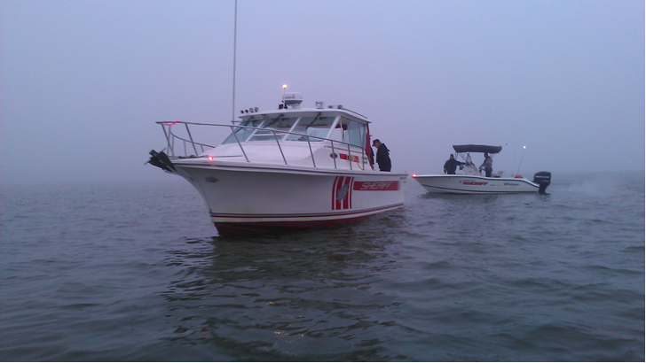
Orleans County Sheriffs Office and Operation Stonegarden/Marine Unit
Criminal Division/Marine Unit: Lake Ontario and Border of Lake Ontario and adjoining counties.
Marine Operations, Intelligence Gathering, Targeted Patrol Functions and Vessel Inspections.
Monitoring Incoming and Outgoing Vessels.
Establishing ongoing relationships with other Federal and State Agencies whose main jurisdiction is on the Great Lakes.
Sharing intelligence data and information.

Slide 12
Orleans County Sheriffs Office and Operation Stonegarden/Marine and Road Units
Criminal Division/Marine Unit and Patrol Division.
Focus on Northern Border and Points of Ingress and Egress into the County.
Focus on major roadway points throughout the county.
Stationary and highly mobile units were developed for deployment.
Multi-agency law enforcement support.

Slide 13
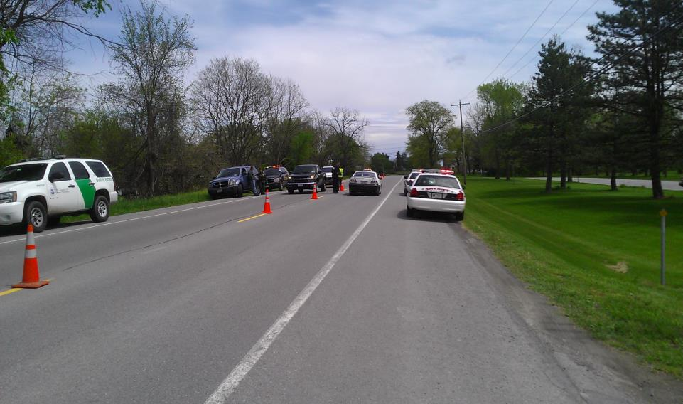
Orleans County Sheriffs Office and Operation Stonegarden/Multi-Agency Support
U.S. Customs and Border Patrol: Support personnel for all marine and patrol operations, provided multi-lingual (Spanish) speaking officers for marine and road patrols.
New York State Police and Park Police: Support personnel for all marine and patrol functions, emphasis on Lake Ontario Parkway and Parks and Recreational Areas
U.S. Immigration and Customs Enforcement: Support personnel for all marine and patrol operations, provided computerization and Livescan services.
New York State Conservation Police: Support personnel for all marine and patrol operations, provided PackEye Radiation Detection Systems Support for all vessels and vehicles

Slide 14
Operational Strategies
Land, Nautical and Air Operations Strategies Inclusion of Multi-Lingual Officers in All Details Utilization of Radiation Detection Systems for all Land and Nautical Details Employment of the K-9 Drug Sniffing Unit Utilization of Mobile and Clandestine License Plate Readers Continual Use of Technology in the Deployment of All Details including underwater and night camera systems, mobile radiation units, surveillance systems strategically placed in high traffic areas Continual Coordination of Intelligence with all Federal, State and Locals Authorities

Slide 15
Operational/Organizational Readiness Expansion of patrol functions along Lake Ontario Northern Border by over 13, 000 mile
Stonegarden Orleans
To include the expansion of routine patrol and marine
patrols on Lake Ontario and the Erie Barge Canal System
Implementation of a camera/video surveillence system along Lake Ontario
Implementation of radiation detection systems along major highways (Canadian) and Lake Ontario
Utilization of the Live scan system on all land and water operations

Slide 16
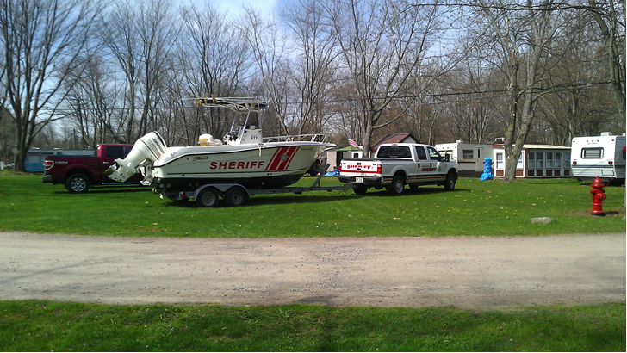
Orleans County Sheriffs Office and Operation Stonegarden/New Purchases
Support Equipment Purchased for Existing and Future Operations
One Truck and 28 Foot Trailer for mobile operations
One Jet Boat for Lake Ontario and marine patrols
Multi-Camera System for Lake and Border Surveillance
Multiple GPS, Night Operation, Underwater Camera Systems, Laptops Computers and Mobile and Stationary License Plate Readers

Slide 17
Stonegarden 2013 to 2016
Expansion of operational readiness to include the extensive use of video camera surveillance systems.
Purchase of additional night vision equipment and expansion of nighttime operations.
Development of closer linkages and ongoing partnerships with Federal and State Law Enforcement Agencies for expansion of patrols.
Purchasing of additional safety equipment including SCUBA equipment for joint operations with local and regional law enforcement agencies.

Slide 18
Stonegarden Con’t 2013 to 2016
Development of collaborative linkages with Canadian Law Enforcement and Border Security Authorities for operational expansion.
Increased land and marine patrols to include twenty four hour operations.
Introduction and discussion on the use of drones and other unmanned aerial equipment to support land and marine operations
Expansion of the K9 unit to include bomb sniffing dog capabilities

Slide 19
Effectiveness Measures

Slide 20
Orleans County Sheriffs Office and Operation Stonegarden/Initial Three Year Summative Report
Total Vehicle Stops – 9,526
Total Vessel Contacts - 103
Total Citations Issued – 138
Total Misdemeanor Arrests – 7
Total Federal Arrests – 6
New equipment purchases of $118,000
Notes:
During the initial start up phase of Operation Stonegarden/Orleans the following was accomplished:
Development of a Regional Task Force whose membership included Federal, State and Local Law Enforcement Agencies (F.B.I., CBP, ICE)

Slide 21
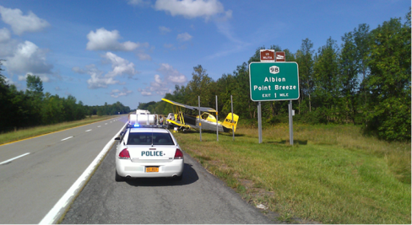
Operation Stonegarden/Orleans Suggestions
Conduct Extensive Planning for all Missions and Operations
Conduct Extensive Post Evaluations for all Missions and Operations and Share Information
Collect information to avoid the “black box” phenomenon
Conduct a more thorough qualitative and quantitative data

Slide 22
QUESTIONS

