Slide 1
Diving Further into the Drug Court Black Box: What We Can Learn from Drug Court Clients
Ellen Ballard – Georgia State University Department of Criminal Justice
Lee Brooks and Ta’Nesha McAuley-Morris – Superior Court of Fulton County Accountability Courts Program
November 7, 2014
Criminal Justice Association of Georgia Annual Conference
Kennesaw, Georgia

Slide 2
Inside the Black Box
Previous research has explored:
Types and mix of treatment programs that contribute to program success
Treatment provider/counselor characteristics that encourage program success
Types of program characteristics such as rewards, sanctions, and testing that contribute to program success
What can we learn from the clients themselves?

Slide 3
Fulton County Adult Felony Drug Court
Largest drug court in the state
Combines treatment and case management
Served approximately 3,670 clients since inception
18 – 24 month program

Slide 4
Study Objectives:
Conform to the evaluation requirements outlined by the Judicial Council of Georgia Administrative Office of the Courts in section 8 of the Standards for Georgia Accountability Courts – Drug Court Standards.
Drug court administrators wanted to better understand how program factors and client characteristics influence client outcomes.
Identify critical drug court program factors and client characteristics that trigger client drop out.
Identify critical drug court client and program characteristics and events that encourage successful program completion.
Develop a program specific risk assessment instrument to be used in conjunction with a standardized risk assessment measure (LSI).
To meet these objectives, a client outcomes analysis was completed.

Slide 5
Client Outcomes Analysis: Design
Multivariate logistic regression
Inclusion Criteria:
– Previous 5 years (2008 – 2013)
– All closed cases for which the client spent at least 30 days in the program
– Subgroup analyses (gender and phase)
– 592 clients were included in the analysis.
– 30.7% of clients included successfully completed the program.
– 69.3% of clients included were terminated from the program.

Slide 6
Client Outcomes Analysis: Findings
Clients serviced by the Fulton County drug court program are both high risk and high need.
– Male
– Between 35 and 50 years old
– Nonwhite
– Homeless
– Unemployed
– Unmarried
– Has experienced a sizable number of prior arrests
– Uses crack/cocaine
– Has abused substances for more than 10 years.

Slide 7
Client Outcomes Analysis: Findings
The factors most salient to program success include gender, number of children, education, employment, ratio of failed drug screens to number of screens taken, ratio of missed drug screens to attempted drug screens, and severity of substance abuse.
Missed drug screens are more predictive of program failure than failed drug screens.
The factors most salient to program success for women are still largely unknown.
Women explained variance = 44.1%
Men explained variance = 84.7%
As clients move through the program, the factors most salient to program failure fluctuate and change.
Factors most salient to program failure are both amendable and reactive to programming, treatment, and services.

Slide 8
Variance Explained – Women
Union City
Homeless / indigent
Mental Health Court

Slide 9
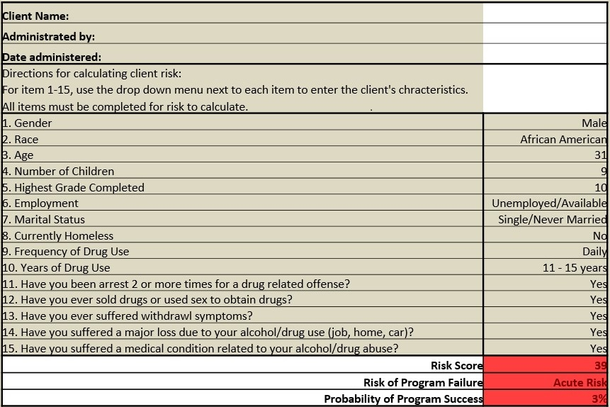
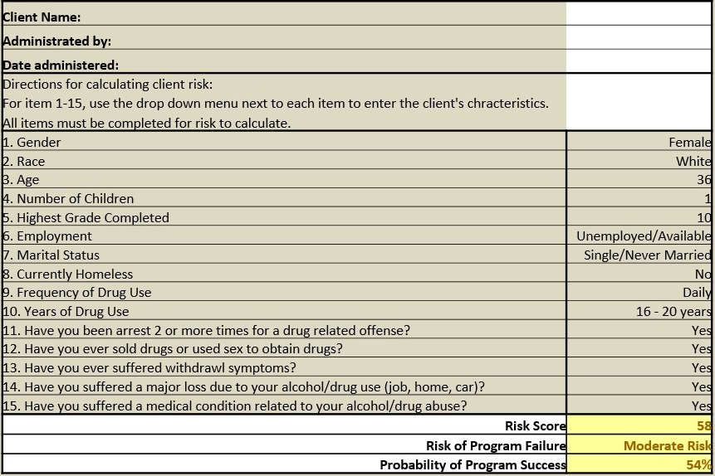
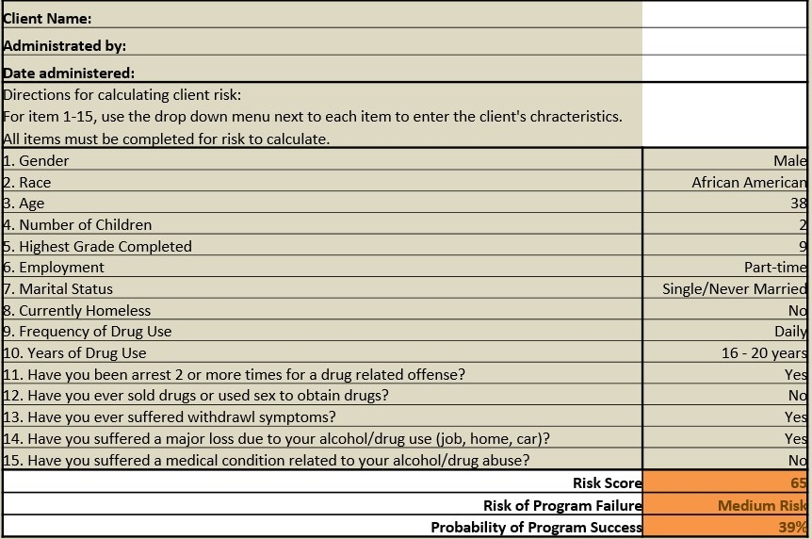
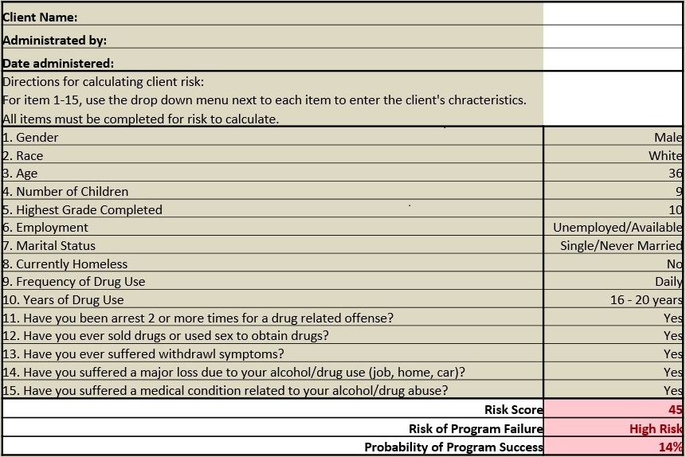
Program Specific Risk Assessment Tool

Slide 10
Behavioral Response Strategy
Traditional sanctioning strategies do not work with this client population
High risk and high need
Revised sanctions from punitive to constructive
Graduated and personalized to client’s risk, need, and phase
Takes mitigating and aggravating factors into account
Identifies client’s capabilities, deficiencies, and opportunities

Slide 11
Additional Actions:
Further investigate the factors most salient to women’s program success.
Monitor and evaluate effectiveness of risk assessment tool and behavioral response strategy.
Expand data collection efforts.
Better understand the effect of program features on client success and failure (types and dosages of treatment clients received, types and amounts of services clients utilize, etc.)
Data should be recorded and maintained at the client level facilitating more sophisticated analysis (i.e. structural equation modeling and hierarchal linear analysis).

