Slide 1
Criminal Investigation in Nigeria:
“A reverie”
Patrick I Ibe Ph.D.
Department of Criminal Justice and Sociology.
Uzoma A Okafor Ph.D.
Department of Natural and Forensic Science. Albany State University.
2014

Slide 2
Table of Content
Introduction
Nigeria: Federalism
Forensic Investigation and the Nigeria Criminal Justice System
Improvement Of The Criminal Investigation Activities
Common Ethical Issues

Slide 3
Introduction
Crime is one of the continuous problems that bedevil the existence of mankind. Crime started in the primitive days as a simple and less organized issue, and ended today as very complex and organized.
Nigeria has one of the alarming crime rates in the world. Cases of armed robbery attacks, pickpockets, shoplifting and advance fee fraud (419) have increased due to increased poverty among population.

Slide 4
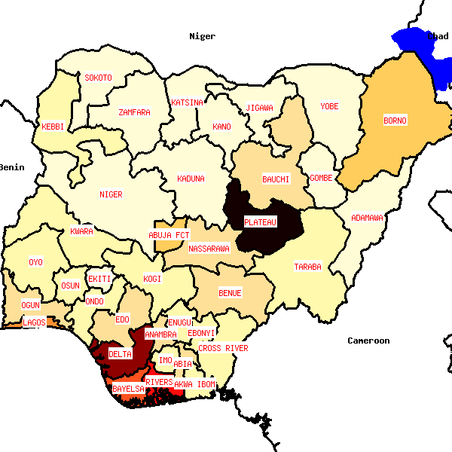
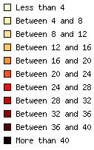
Crime rates in Nigeria (homicides per 100,000 inhabitants)
Nigeria Watch: Third Report on Violence (2006-2011)

Slide 5
A lot has been said and written about criminal justice administration in Nigeria, its challenges and the injustices of its machinery. However, the predominant focus has been directed towards issues of prison congestion, capital punishment, police brutality and the awaiting trial inmates phenomenon, who though are not convicted persons, but as at 2006 accounted for about 65% of the number of persons incarcerated in Nigeria's prisons.

Slide 6
Goals of the Criminal Justice System
Controlling
Crime
Preventing
Crime
Doing
Justice

Slide 7
Nigeria: Federalism
A system of government in which power is divided between a central (national) government and regional (state) governments.
In respect to substantive law the Criminal Code Act applies in the Southern states and the Penal Code Act applies in the Northern States

Slide 8
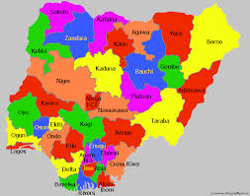
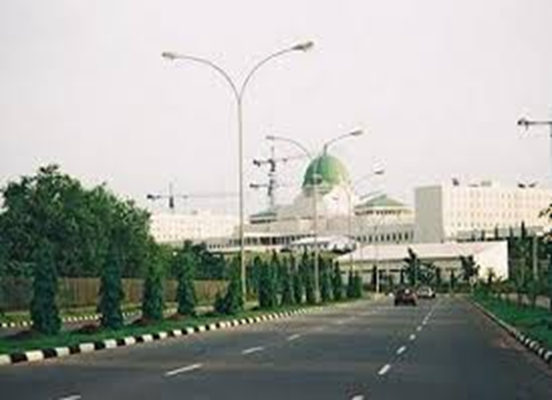
Dual Justice Systems
State systems handle alleged violations of state law.
The federal system handles alleged violations of federal law.

Slide 9
Forensic Investigation and the Nigeria Criminal Justice System
The complexity of the role police have in law enforcement should not be underestimated.
The police are entrusted with a diverse set of tasks to maintain peace and security and the rule of law.

Slide 10
Despite a visible police presence in large cities, police assistance does not have a wide reach.
A serious lack of resources, including communications equipment, vehicles, skilled leadership, and training, continued to undermine the effectiveness of the Nigerian Police Force.

Slide 11
Forensic investigation Nigeria is bewailed with various façade with no known forensic institution; yet crime has become more sophisticated and organized.
If the Nigerian police force is to break grounds and push its boundaries of investigation, it must develop expertise in forensics.
Notes:
There seem to be no concerted effort by government to develop this line of technique in crime investigation, despite the obvious good it will do to accused persons, and those innocently and wrongfully convicted.

Slide 12
Improvement Of The Criminal Investigation Activities
Funding
Corruption
Forensic Laboratories and Experts
Training of Investigating Police Officers
Ethical Issues

Slide 13
Logical Matrix for Ethics in Forensic Investigation
Ethical Standard in Forensic Science
Ethical Standard in Criminal Justice
Ethical Standard in Science

Slide 14
MORALS:
Ethical Standard
high standard of honesty & honorable conduct with methods of reinforcement-
Professional Requirement
Moral Standard
Generally accepted customs of conduct in a given society
Personal Choice

Slide 15
Violation Range
Personal/Professional
Ethical Misdemeanor
Ethical
Violations
Misconduct/
Misbehavior
Criminal
Violation

Slide 16
Common Ethical Issues
Misrepresenting qualifications or credentials
Pressured testimony (adrenaline factor)
Omitting unfavorable information
Lying about the knowledge of the evidence planted
Falsifying the data or notes
Biased examination

Slide 17
Ethical Issues at Agency Level
7) Discrepancies in ethical guidelines
8) Determination of ethical violations
9) Lack of specific training on unethical situations
10) Need for a disciplinary Forensic Ethics

Slide 18
Recommendations
The most recent data acquisition requirement for telecommunication usage can be taken as an advantage to developing an indexing system for both fingerprinting and facial recognition evidence based investigation.
There is need to develop a DNA data based system that can be used to track and individualized evidence and perpetrators
Establishing a standard forensic science laboratory centers in all geopolitical zones this will further support and help curb crimes in timely manner

Slide 19
Recommendations on Ethical issues
Accurate representation of qualifications
Maintain the integrity of the evidence
True and accurate representation of data
Clear and complete documentation
Impartiality of the examination
Impartiality of testimony
Confidentiality and disclosure
Reporting of colleagues who violate the profession’s ethical code.

Slide 20
References
Uche, 2008
Financial, 2011
^{UNODC 2014}
^{Miller et al 2000}
^{Ladapo A.O., 2012}
^{Nte 2012}
^{Opera LC 2014}
^{Noel Otu 1999}
^{Ayorinde et al., 2014}

