Slide 1
Offense typologies related to detection avoidance in sexual homicides
The one that got away
Samantha Balemba, Ph.D. Assistant Professor Department of Criminal Justice, University of North Georgia
Eric Beauregard, Ph.D. Associate Professor School of Criminology, Simon Fraser University, BC Melissa Martineau, M.C.A.
Manager, Research and Development Behavioural Sciences Branch, Royal Canadian Mounted Police
November, 2014

Slide 2
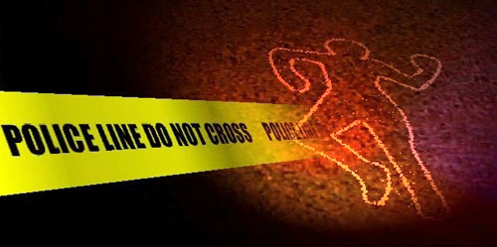
Introduction
Sexual homicide literature most often examines sexual murderers, rather than sexual murders
Police investigators usually don’t know the identity of the perpetrator at the beginning of an investigation
What is known immediately?
Crime scene factors!
Notes:
Murderers: e.g., social isolation, childhood attachment/abuse, psychopathology/PDs, deviant fantasies
In the early stages of an investigation, police won’t be able to apply known relationships about offender-specific traits
Crime scene factors independently: DNA evidence can individualize an offender; stolen items can be traced; excessive physical violence can leave impression or trace evidence; indicators of MO can link cases
BUT can also combine these factors to create offense types

Slide 3
Research Foci
Analyses will illuminate latent classes of sexual homicide offense types based on crime scene factors
Determine factors that can aid in investigations before the identity of the perpetrator is known
Specific consideration of unsolved cases, as these are arguably the most problematic for investigators
Notes:
- Using latent class analyses

Slide 4
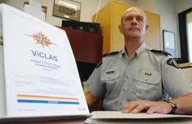
Data
Violent Crime Linkage Analysis System (ViCLAS)
Link violent crimes across jurisdictions
Completion of ViCLAS crime reports mandated by the RCMP and within Ontario and Quebec
Contributions from other provincial and municipal police, although voluntary, are fairly consistent
Data collection began in 1991-1992, but prior incidents have also been entered (case dates: 1948-2010)
Examined all cases of sexual homicide (N = 350)
Had to meet the definition of sexual homicide provided by the FBI (Ressler, Burgess, & Douglas, 1988)
Notes:
ViCLAS: computerized tool developed by the RCMP to aid investigations of violent crime; links crimes across jurisdictions
To be considered a sexual homicide, had to include/make note of:
Victim’s attire or lack thereof
Exposure of sexual parts of victim’s body
Sexual positioning of body
Insertion of foreign objects into body cavities
Sexual intercourse
Substitute sexual activity, interest, or sadistic fantasy

Slide 5
Crime Scene Variables
 |  | N | %
Case status
 | Solved | 250 | 71.4%
 | Unsolved | 100 | 28.6%
Vaginal intercourse
 | No | 188 | 53.7%
 | Yes | 162 | 46.3%
Offender took items
 | No | 218 | 62.3%
 | Yes | 132 | 37.7%
Anal intercourse
 | No | 293 | 83.7%
 | Yes | 57 | 16.3%
Semen located
 | No | 253 | 72.3%
 | Yes | 97 | 27.7%
Mutilation of victim
 | No | 266 | 76.0%
 | Yes | 84 | 24.0%
 |  | N | %
Inanimate object inserted
 | No | 309 | 88.3%
 | Yes | 41 | 11.7%
Victim’s body moved
 | No | 231 | 66.0%
 | Yes | 119 | 34.0%
Violence – beating
 | No | 185 | 52.9%
 | Yes | 165 | 47.1%
Restraints, blindfolds, gags
 | No | 298 | 85.1%
 | Yes | 52 | 14.9%
Violence – strangulation
 | No | 204 | 58.3%
 | Yes | 146 | 41.7%
Notes:
- Case status: included within full sample analysis and used to split the sample for analysis of unsolved only cases
- Variables chosen from combination of successive results of two-step cluster analyses and their relationship to case clearance

Slide 6
Latent Class Model
Variable | Cluster 1 (33.9%) Sloppy/Reckless | Cluster 2 (33.2%) Violent/Sadistic | Cluster 3 (33.0%) Forensically Aware
Case status*** | Solved (83.3%) | Solved (80.5%) | Solved (50.1%)
Vaginal intercourse* | Yes (81.1%) | Yes (55.4%) | No (98.8%)
Items taken† | No (57.0%) | No (56.4%) | No (73.6%)
Presence of semen** | Yes (61.3%) | No (79.5%) | No (99.6%)
Mutilation of victim* | No (85.4%) | No (59.3%) | No (83.2%)
Inanimate object | No (99.8%) | No (75.0%) | No (89.8%)
Violence – beating*** | No (65.5%) | Yes (78.7%) | No (71.7%)
Restraints, blindfolds, gags | No (80.6%) | No (82.8%) | No (92.2%)
Violence – strangulation** | No (53.9%) | Yes (55.1%) | No (76.3%)
Note. †p < .10. *p < .05. **p < .01. ***p < .001.
Full Sample
Notes:
N = 350

Slide 7
Latent Class Model
Variable | Cluster 1 (60.7%) Forensically Aware | Cluster 2 (39.3%) Not Forensically Aware (Lucky)
Vaginal intercourse* | No (98.2%) | Yes (68.5%)
Items taken† | No (69.4%) | Yes (51.9%)
Presence of semen* | No (99.8%) | Yes (55.6%)
Mutilation of victim | No (85.2%) | No (71.9%)
Inanimate object | No (89.5%) | No (85.7%)
Violence – beating** | No (74.3%) | Yes (59.5%)
Violence – strangulation** | No (76.4%) | Yes (60.2%)
Note. †p < .10. *p < .05. **p < .01.
Unsolved Only Sample
Notes:
N = 100
Lucky guys just more likely to do everything.

Slide 8
Supplementary Analyses
Victim Characteristics
Clusters not influenced by any victim variables
Gender, age, race, prostitute
Clusters of offending behaviour stable across victim types
Crime Characteristics
Full sample:
Anal intercourse (Sloppy/Reckless)
Overkill, crushing, stomping (Violent/Sadistic)
Unsolved only sample:
Anal intercourse, stomping (Lucky)
Body disposal (Forensically Aware – conceal body; Lucky – lack of concern for disposal)
Notes:
Using a variable that determined modal cluster assignment, chi-square analyses conducted to determine if clusters differed according to certain victim and crime characteristics not included in the latent class analyses
Overall, supplementary analyses only further supported the latent class results

Slide 9
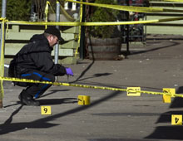
Discussion
Sloppy/Reckless group
Most likely to be apprehended due either to a lack of planning or a lack of concern for detection avoidance
Priority = sex
Violent/Sadistic group
Almost as likely to be apprehended by police, but not because of sexual evidence
Priority = violence and torture
Forensically Aware group
Least likely to be apprehended
Priority = detection avoidance
Notes:
Sloppy/Reckless:
Intercourse with the victim, semen at the scene; either doesn’t use a condom or doesn’t use or dispose of it properly
Offender isn’t concerned with excessive force, such as a physical beating, and almost never employs mutilation techniques
Violent/Sadistic:
Most likely to mutilate their victim as well as insert foreign objects into the victim
Incorporate a physical beating and strangulation, as well as use crushing and stomping types of violence and overkill
Expressive, or just excessive, amounts of violence, beyond what’s necessary to commit a sexual homicide
Forensically Aware:
Least amount of behaviours that are likely to lead to detection
Do not have intercourse with their victims, virtually never leaving semen
Least overall violence; lowest likelihood of a physical beating or strangulation of the victim
The victim is murdered, yes; best interpreted as a predominance of instrumental violence; offender “gets the job done” with as little extraneous activity as possible
There must be a sexual element to the crime for it to be classified as a sexual homicide, but main focus is to execute the attack in a way that allows for maximum likelihood of detection avoidance

Slide 10
Unsolved sexual homicides
Forensically Aware group
Similar to Forensically Aware group from full sample
But offenders all successful at detection avoidance
Not Forensically Aware/Lucky group
Based on offender behaviour, there should have been enough evidence for apprehension and arrest
So, why so difficult to solve?
Sometimes criminals just get lucky
Notes:
Forensically Aware:
Dominated the unsolved sample model (almost 2/3 of unsolved cases)
Lack of intercourse, resultant absence of semen
Avoid contact with the victims as much as possible; no mutilation, less violence; offenders very likely to conceal the body
Suggests a degree of planning and sophistication
But all got away with it! (differ from group in full sample)
Lucky:
Over 1/3 of unsolved sexual homicides
Involve intercourse, semen was recovered at the scene
More likely to involve mutilation, insertion of foreign objects
More violent, whether through beating, strangling, or stomping
In over half of cases, offender took items from the victim or scene
Rather than attempt to hide the victim’s body, lack of concern for body disposal
Why so difficult for police to clear? Crimes = sloppy, unplanned, unsophisticated
Particularly bizarre given the police resources dedicated to all murders
Non-routine nature of a sexual homicide in particular; a lot of time, resources, and effort from local law enforcement
Case-by-cases analysis: may be some factor that made the case difficult (location presenting unforeseen difficulties, witnesses becoming uncooperative/lacking useful information, key biological evidence too degraded)
Hope the same offender won’t be so lucky twice?

Slide 11
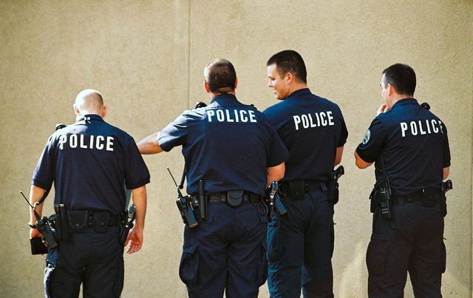
Implications
Help investigators right from the beginning of an investigation
Give an idea of what to look for (evidence of sex vs. violence)
Forensically aware crime will require more police work
Police must stay ahead of the criminals!
It’s not all about the DNA!
Must not discount the power of circumstantial evidence
Little that can be done when offenders get lucky
Notes:
Almost immediate determination of the type of offense just by looking at observable crime scene factors
Forensically Aware crime = more police work (offender’s focus on detection avoidance)
Police must stay ahead of the criminals wrt forensic recovery and analysis techniques
Offender wears and disposes of a condom, investigators use stronger methods to recover skin cells or hair follicles
Not overly violent, crime still requires enough force to kill the victim; should be either evidence of a weapon or tool – or even the offender’s hand – used to complete the murder
If no restraints, maybe evidence of other method used to reduce victim resistance (chloroform or Rohypnol)
Must not allow the gap between the information and resources that the offender has and that available to police to close
Strong cases can be built using only circumstantial evidence
Enough circumstantial evidence = same individualizing power of a single DNA match
Little that can be done about the circumstances that must have led to an unsolved case status
Police at fault? (Should have been easily solved); no evidence to blame competency or work ethic of police
Error within any statistical, investigative, or forensic tool; cases just represent that error?
Always offenders who slip through cracks of CJS
BUT still more cases closed than not; even forensically aware offenders still getting caught at least 1/2 the time; police aren’t powerless to protect public; with more information, we may be able to increase this number even more

Slide 12
Thanks for listening!
Samantha Balemba, Ph.D.
Assistant Professor
Department of Criminal Justice
University of North Georgia
82 College Circle
Dahlonega, GA 30597
Email: Samantha.Balemba@ung.edu

