Slide 1
Technology in the Classroom Prohibit, Adapt or Adopt?
Leah Daigle, Ph.D. Michael B. Shapiro, J.D. Georgia State University

Slide 2
The Dilemma
Our students are using technology everywhere in their lives:
At home
On the road
In class
82% of Generation Y is connected wirelessly.
Do we, as faculty, attempt to prevent their use of technology in the classroom, or do we find a way to incorporate it into our lesson plans?
If the latter, what are some of the options available?

Slide 3
Our Use of Technology
We, and our students, are already using technology for class purposes:
PowerPoint lectures
ScanTron testing
Internet searches
Is it fair for us to prohibit the use of technology in the classroom?
Our students are “connected” 24/7. Should we expect them to disengage for our classes?

Slide 4
Issues with Technology
Average student uses digital device almost 11 times during class throughout the day for non-class purposes (McCoy, 2013)
30% of instructors have no policy regarding use of digital devices, but most students indicated that they thought instructors should have one (McCoy, 2013)
Research shows that students who actively text during class do worse on quizzes specifically designed to measure content about that class (Froese, 2012)
The current generation of students are known as “Digital Natives” for a reason, they’ve grown up always knowing and using technology.
Notes:
Most common – 86% said texting, 79% checked the time, 68% checked email, 66% social networking, 38% websurfing, 8% playing games, and 4% other

Slide 5
University Technology
Our schools are already using technology:
Desire2Learn
TurnItIn – Originality Report and GradeMark
Wimba
Video Conferencing
Echo 360 (“GPC Rewind”)

Slide 6
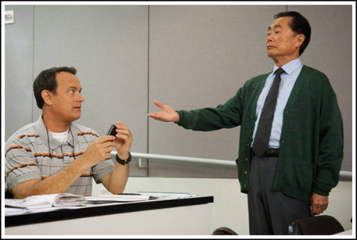
Technology Control Options
If we permit technology in the classroom, we may wish to limit its use. Some options include:
Requiring technology users to sit in the back of the classroom so as not to disturb/distract others
Requiring technology users to sit in the front of the classroom so as to be revealed when using technology.
Allowing students to establish a classroom technology use policy, including “punishment” for violation.

Slide 7
Classroom Response Systems
Classroom Response Systems allow “polling” of the audience. Some have proprietary systems, others provide “apps” for “smart phones”. Instant analysis.
Options include:
i>clicker (http://www1.iclicker.com/)
Top Hat (https://tophat.com/)
Turning Point (http://www.turningtechnologies.com/)
Poll Everywhere (http://www.polleverywhere.com/classroom-response-system)

Slide 8
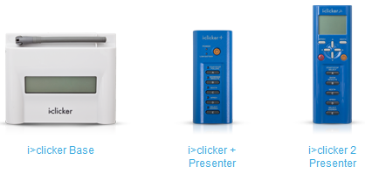
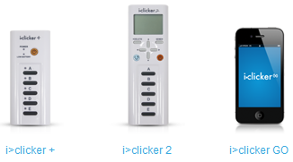
i>clicker
Base unit and presentation unit provided to faculty at no charge. Students may either purchase a proprietary response device (~$30-55) or an “app” for their “smart phone” (i>clicker GO ~$10/semester).
i>clicker 2 permits multiple choice, short answer (16 characters), matching or numeric answers.
Supported by many USG schools.

Slide 9
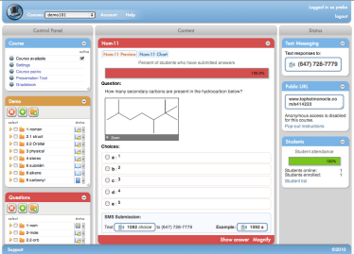
Top Hat by Monocle
Cell phone based. Students use their own device, with text messaging for “dumb” phones and either an “app” or their “browser” on “smart phones”.
Working agreement with some publishers, including Pearson.
Cost is either $20/semester or $38/five years.
Top Hat permits multiple choice, short answer (500 characters), matching or numeric answers.

Slide 10
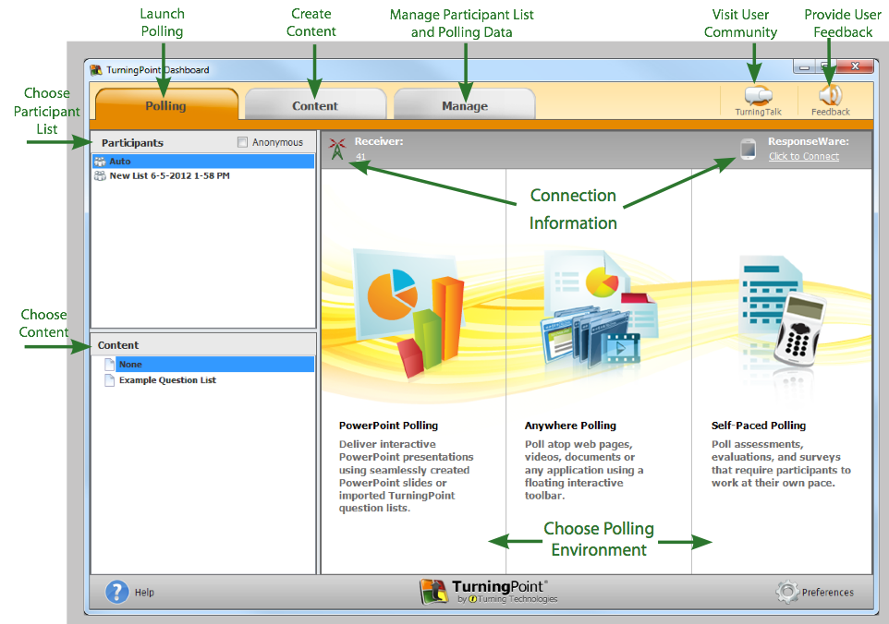
Turning Point
Students purchase proprietary response devices ($35-65).
Available in Windows and Mac formats.

Slide 11
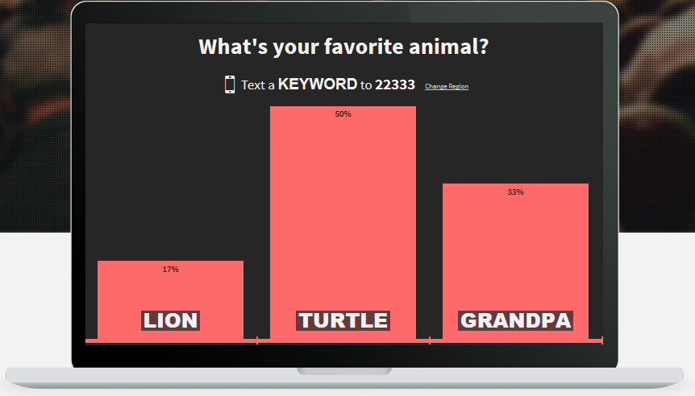
Poll Everywhere
Poll Everywhere uses simple text messaging. Students use their own cellular telephones and incur no charges other than for the text messaging.
Pricing ranges from free for up to 40 respondents, to $15/month for up to 50 respondents, and $65/month for up to 250 respondents.

Slide 12
Ways to Use a Classroom Response System
Classroom Response Systems have multiple uses, including:
Taking attendance
Gauging student preparation before the lecture to permit “on the fly” adjustment
Gauging student comprehension during or after the lecture
Review prior to quizzes or exams
Administration of quizzes or exams

Slide 13
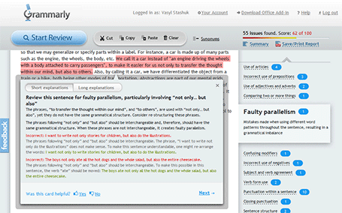
Grammarly
Grammarly (www.grammarly.com) is a writing-enhancement platform with proofreading and plagiarism-detection capabilities check for a writer’s adherence to more than 250 grammar rules.
Students can submit drafts to the website for almost instant critique.

Slide 14
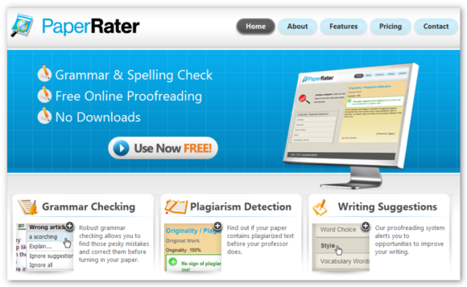
PaperRater
Like Grammarly, PaperRater (http://www.paperrater.com/) does both proofreading and plagiarism-detection.
Use of the site is free.

Slide 15
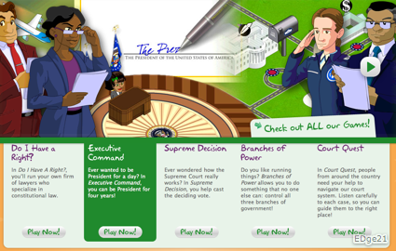
icivics
Founded by former Associate Supreme Court Justice Sandra Day O’Conner, icivics (http://www.icivics.org/) is an interactive website with free educational materials about our government and legal system.

Slide 16
Collaboration/Discussion
Post questions to Piazza or Yammer to stimulate out of class discussion,
where students work together to create the best response
Notes:
Yammer is FB for business
Piazza is specifically designed for academics
Posts are edited wikipedia style, so that your students can collaborate on the best response
Announcements are accompanied by email notifications, to notify your class of important information
Group messaging allows interaction between smaller sections
Piazza supports multimedia embedding so you and your students can share images and videos
Our follow-up discussion area allows students to further discuss questions and topics
Our statistics page tracks student participation for instructors

Slide 17
Questions?

