Slide 1
School Violence in Rural Areas: Prevalence, Explanation and Prevention
Dr. Timothy C. Hayes
University of North Georgia

Slide 2
Why Rural?
Theories that do not account for variations in rural crime are being viewed as limited (Weisheit and Donnermeyer 2000)
In Addition:
Rural Crime has not declined as rapidly as crime in the urban setting
Rural crime represents a relatively small proportion of the volume of crime in the US, but...
The share of rural crime (compared to cities and suburbs) has grown

Slide 3
Why Rural Violence/Crime (contd.)?
Relative risk of violence within rural areas is largely unchanged over the past few decades
Rural crime has not changed in the same manner as urban crime

Slide 4
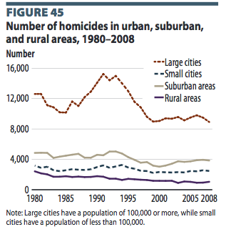

Slide 5
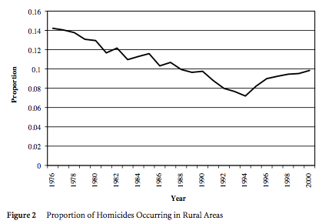

Slide 6
School Violence and other Issues in Rural Areas
Bullying
Dating Violence
Presence of Drugs / Alcohol - Is this a factor?

Slide 7
Bullying in Rural Schools
Wide range of estimates due to difference in definitions
Study in Rural Illinois - 34% of students reported that they had been bullied. (Stockdale, et al. 2002)
Significantly higher than in urban locations. (9.7% reported being bullied in rural vs 6.7% in urban) (DeVoe, et al, 2004)

Slide 8
Dating Violence in Rural Schools
Foshee, et al. (1998) - 34.9% of females and 38% of males reported being a victim at least once
Spencer and Bryant (2000) - 12% of rural teens report experiencing dating violence once, 16% report several times
McDonell, Ott and Mitchell (2010) - 27% of females and 17.8% of males report dating violence

Slide 9
Prevention Programs
Second Step Program (1st through 5th grade)
RIPP - Responding in Peaceful and Positive Ways (6th, 7th, 8th grade)
Safe Dates - Aimed at Dating Violence in 8th and 9th grade
School Resource Officer Programs - little formal evaluation

Slide 10
YRBS Data 2013 (Totals by Gender)
 | Male | Female | Total
Carried a weapon | 28.14% | 7.87% | 17.91%
Carried a gun | 9.44% | 1.63% | 5.51%
Threatened or Injured w/ Weapon | 7.73% | 6.09% | 6.91%
In a physical fight | 30.17% | 19.21% | 24.66%
Injured in a physical fight | 3.80% | 2.39% | 3.09%
Fight on school property | 10.66% | 5.64% | 8.15%
Did not go to school - not feeling safe | 5.43% | 8.71% | 7.07%
Bullied on school property | 15.55% | 23.72% | 19.65%
Electronically Bullied | 8.54% | 21.01% | 14.77%

Slide 11
YBRS Data 2013 (Totals by Gender)
 | Male | Female | Total
Physically Forced to Have Intercourse | 4.18% | 10.46% | 7.33%
Physical Dating Violence | 7.43% | 12.99% | 10.25%
Sexual Dating Violence | 6.23% | 14.36% | 10.36%

Slide 12
Further Study
Rural Urban Differences in CDC data…
Evaluation of any existing SRO programs in known areas of CDC data collection
Other structural factors

