Slide 1
Mass Incarceration: How U.S. Incarceration Rates Fare with the rest of the World and How to Decrease our Numbers.
-Compiled & Presented by Patricia Ikegwuonu, J.D.

Slide 2
Abstract
Comparative review of international incarceration rates, focusing on the U.S. in relation to the rest of the world. The U.S. has the highest incarceration rate in the world, and prior to this year, was incarcerating approximately 700 people per 100,000 citizens, which is at least five times higher than that of other countries (Prison Policy Initiative).
Various scholars continue to research this issue, primarily because the ramifications are exhaustive and costly.
Very Recent Update: Although the overall numbers remain high, and we still hold the position of ‘highest incarceration rates’, this past year showed a noteworthy decline.
This review discloses these and other related findings, and more importantly, what the recommendations are which address the issue of decreasing the U.S. rate.

Slide 3
Introduction
In the past year, as of September 2014, the U.S. federal prison population fell by roughly 4,800, the first time in decades the number has gone down (Chappell, 2014).
"Historic" progress, for the U.S. in reducing both its crime and its incarceration rates. (Ibid)
Numbers reflect a reversal from predictions as recently as November 2013, when the federal prison population was projected to stay level in 2014, with nearly 219,300 inmates. Not only did the raw number fall, but so also did the incarceration rate per 100,000 Americans. (Ibid)
In an approximate five-year span, at both the state and federal levels, the overall crime rate and overall incarceration rates fell by around 10 percent. (Has not occurred in 40 years.) (Ibid)

Slide 4
Introduction continued
Last year (2013 – 2014), the rate was down to 478 per 100,000 (Bureau of Justice Statistics) from its usual rate of around 700 per 100,000.
While crime rates have fallen in the past twenty years, it is not attributed to stricter sentences and high incarceration rates, but rather to a commitment to prison population reduction; states involved had also witnessed a reduction in their crime (Pew Charitable Trusts).
West Virginia, the state with the largest increase in its incarceration rate, also experienced an increased crime rate (Chappell, 2014).
New data suggest the trend will continue (Chappell, 2014).

Slide 5
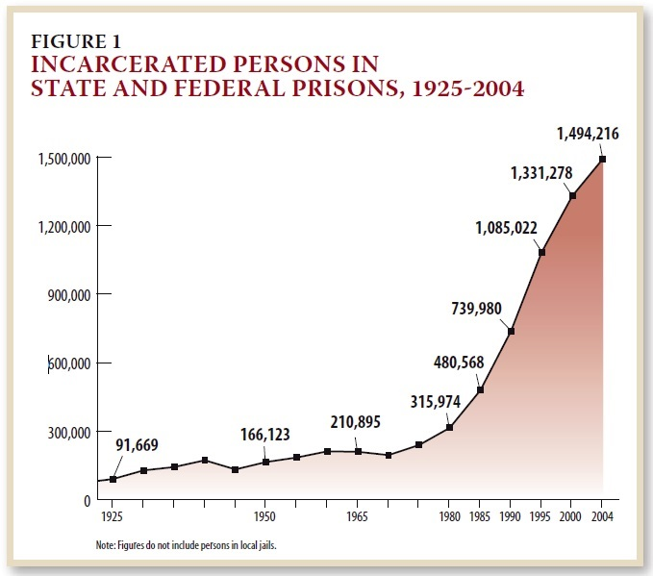
Findings (prior to these most recent ones reporting a decline)
The American penal system for the last forty years (prior to this past year’s decline) dominated by relentless growth (Ending Mass Incarceration).

Slide 6
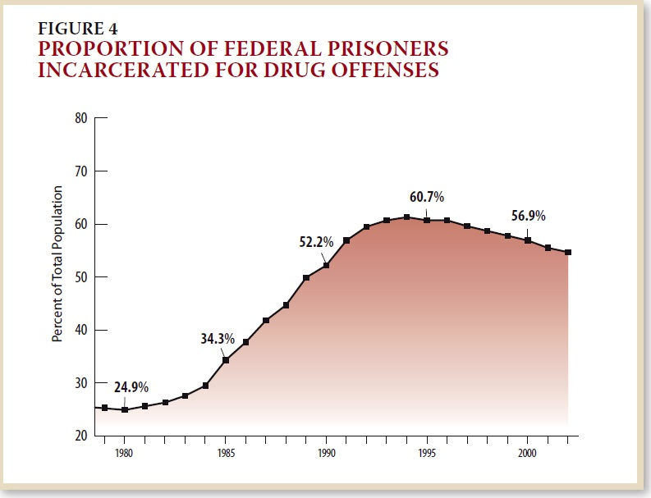
Findings continued

Slide 7
Growth of correctional control: ‘Deliberate’ policy choices imposing intentionally punitive sentences that send more people to prison and keep them there longer. See Table 1.
Table 1: Changes in Correctional Populations 1980-2011
Population 1980 2011 % Increase
Prisons 319,598 1,504,150 371%
Probation 1,118,097 3,971,319 255%
Parole 220,438 853,852 287%
Jails 182,288 735,601 304%
Total 1,840,421 6,977,700 279%
U.S. Population (millions) 227 311 37%
(Ending Mass Incarceration - Bureau of Justice Statistics)

Slide 8
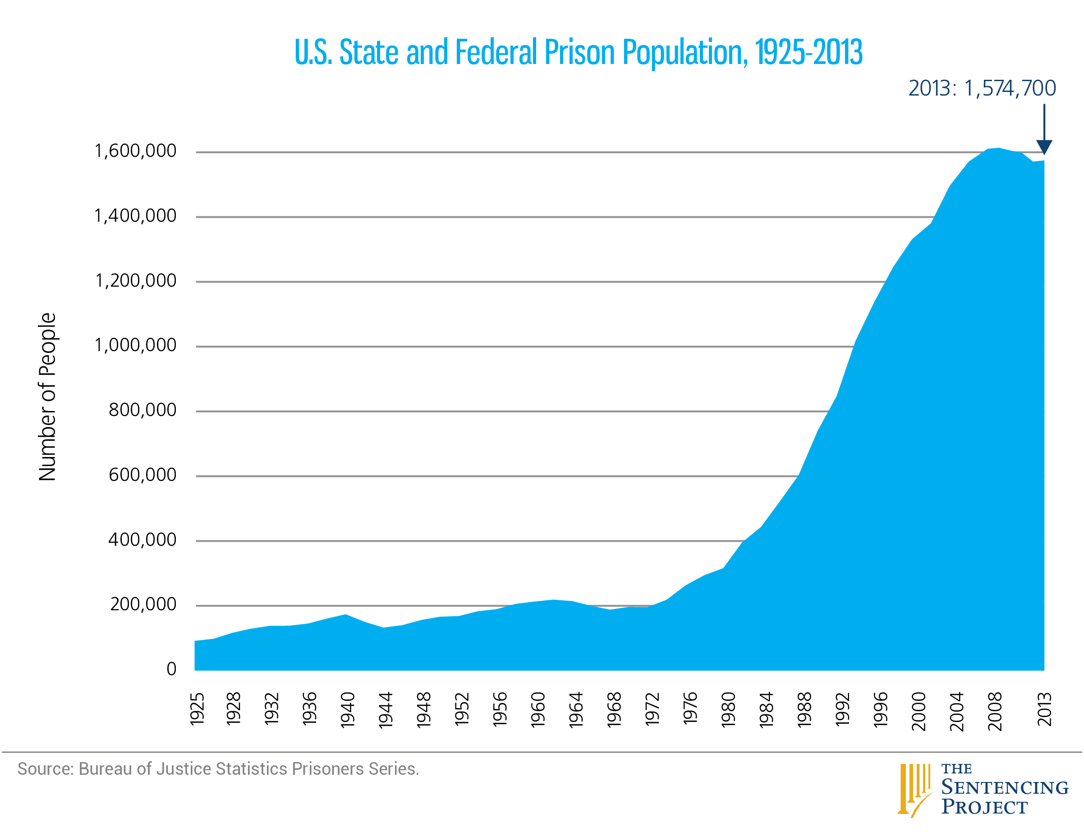
What our numbers looked like through to early 2013

Slide 9
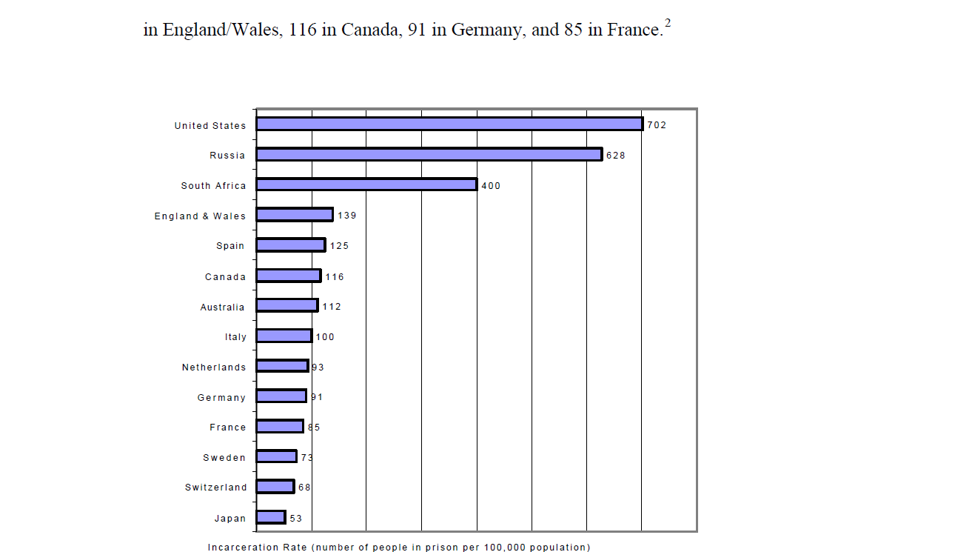
Our Place on the World Stage

Slide 10
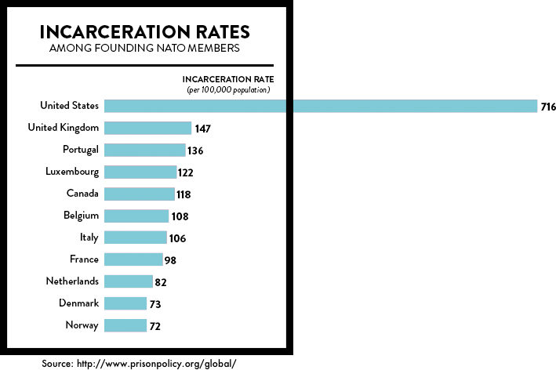
Our Place on the World Stage (Continued)

Slide 11
Our Place on the World Stage (Continued)
Most of the countries with high incarceration rates experienced fairly recent large-scale internal conflict. (Vs. the U.S., which has a long history of political stability, with not a civil war in nearly a century and a half, and yet it tops the list.)
Comparing the incarceration rates of individual U.S. states and territories with other nations, we find that 36 states and DC have higher incarceration rates than Cuba, which is a nation with the alternatively second/third highest incarceration rate in the world.
New Jersey and New York follow just after Cuba. New York is tied with Rwanda, which has the alternatively third/fourth highest incarceration rate.
Next comes Washington state, tied with Russia. (In the wake of collapse of the Soviet Union, Russia used to rival the United States for the highest incarceration rate, but an epidemic of tuberculosis in the overcrowded prisons, encouraged Russia to implement an amnesty program in 1999, significantly lowering their incarceration rate.)

Slide 12
Our Place on the World Stage (Continued)
Utah, Nebraska and Iowa all incarcerate more of their populations than El Salvador, a country with a recent civil war and one of the highest homicide rates in the world.
Minnesota, Massachusetts, North Dakota, New Hampshire, and Rhode Island, U.S. states with the lowest incarceration rates still have higher rates than countries which have experienced major 20th century traumas, such as several former Soviet republics and South Africa.
Maine and Vermont are the two U.S. states which incarcerate the least, but even they incarcerate far more than the United State’s closest allies.

Slide 13
Why?
Culture of punishment and retribution;
Political expediency with “tough-on-crime” policies. (Three strikes; Mandatory minimums)
Example: At the height of the war on drugs in 1992, Clarence Aaron, then a 22-year old football player at Southern University in Baton Rouge, La., introduced a classmate to a high school friend who was a cocaine dealer, leading to a sale of nine kilograms (about 20 lbs.) of cocaine. Aaron himself did not buy, sell or supply any drugs. Still, when Aaron refused to testify against his friends, he received the harshest sentence of anyone involved — three life terms with no parole. He has been serving that sentence for more than 20 years now. (Cole; Mauer, 2013)
From the seven million people under correctional control in the U.S., a disproportionate number are from a small subset of communities in major cities across the country.
- Black, Latino, and poor;
- High rates of unemployment, homelessness, sub-standard schools,
healthcare, and other basic services.
- Same neighborhoods to which most will return after release from prison
and where around four million people are under correctional supervision.

Slide 14
Why? (continued)
This excessively punitive and racially charged system exacerbates injustice, breeds resentment, and undermines the legitimacy of the justice system itself. (Walmsley, 2013)
The consequences? A five-fold increase of our penal system resulting in huge social and financial cost to the country, and continuing a level of mass incarceration that dwarfs that of other countries. (Ending Mass Incarceration)

Slide 15
Impact of Incarceration Compared to Other Interventions
Drug treatment, at-risk family interventions, and school completion programs more cost-effective than increased incarceration.
Expending $1 million to expand mandatory minimum sentencing would result in a national decrease in drug consumption of 13 kilograms, but applying those dollars those to drug treatment would reduce consumption of drugs by 100 kilograms(!!!) (RAND).
Re-appropriating our federal drug budget to reduce funds earmarked for supply reduction by 25% and doubling funding for treatment would decrease cocaine consumption by 20 metric tons and save over $5 billion(!!!) (RAND)
Every $1 invested in drug treatment returns more than $7 in savings to society. (Vs. a net loss of nearly 70 cents for enforcement approaches.) (Sentencing Project:King; Mauer; Young, 2005)

Slide 16
Recommendations
(1.) Reduce admissions to prison for new convictions and re-entry into the system.
(2.) Reduce length of stay in the system.

Slide 17
(1.) Reduce admissions to prison for new convictions and re-entry into the system.
a. Reduce unnecessary arrests, especially for drug crimes.
Research shows that police departments can safely reduce
their felony arrest rates. Significant impact on correctional
populations.
b. Eliminate unnecessary pretrial detention.
Nationally, approximately 60 percent of the jail population is
awaiting trial; many charged with nonviolent offenses still
confined because they cannot afford bail.
c. Reclassify some drug and other crimes.
Will result in reduction of the overall number housed in
jails and sentenced to prison.

Slide 18
(1.) Reduce admissions to prison for new convictions and re-entry into the system. (Cont’d)
d. Eliminate mandatory minimum sentences.
- Racially discriminatory impact;
- Unnecessarily result in thousands being sent to prison
on nonviolent or drug offenses; and
- The imposition of sentences that are not proportional to
the crimes committed.
e. Eliminate revocations to prison for probation and parole
violations.
f. Require Racial Impact Statements.
- Reveal hidden racial impacts of proposed changes to
the justice system. (Ending Mass Incarceration)

Slide 19
(2.) Reduce length of stay in the system.
a. Acknowledge the harsh nature of our penal systems by implementing significant sentencing reforms, such as:
- Reducing sentence lengths overall; fair and proportionate
to the offense (including reclassifying some drug and
other crimes and eliminating mandatory minimums);
- Eliminating or reforming habitual offender laws; and
- Prohibiting life sentences for all but the most serious
crimes.

Slide 20
(2.) Reduce length of stay in the system. (Cont’d)
b. Increase eligibility for earned discharge from probation and parole, as well as work and education release. Those who fare well under supervision can be released and move forward with their lives.
c. Develop mechanisms for back-end release from jail and prison, including earned eligibility for good time, merit time programs, and increased eligibility for parole in states that use it. (Ending Mass Incarceration)

Slide 21
Thank you!
Louisiana is the world’s prison capital. The state imprisons more of its people, per head, than any of its U.S. counterparts. First among Americans means first in the world.
—Cindy Chang, The Times-Picayune, May 13, 2012

