Slide 1
FIFTY YEARS ON AND STILL HALF GONE?
ROBERT C. LIGHTFOOT
SOUTH GEORGIA STATE COLLEGE

Slide 2
THE ONGOING SITUATION
For over fifty years, doctoral programs in the Social Sciences and Humanities have had an attrition level of around 50%.
For every two people admitted, only one finishes.

Slide 3
THE COST
Graduate School is very expensive, especially for a multiple year process, and the debt burden continues for decades in many cases. This even applies to unsuccessful candidates.
The Department also incurs costs in time, training, professorial duties, reputation, and lost opportunities if someone does not complete.
There have even been cases of suicides and homicides due to failed attempts.

Slide 4
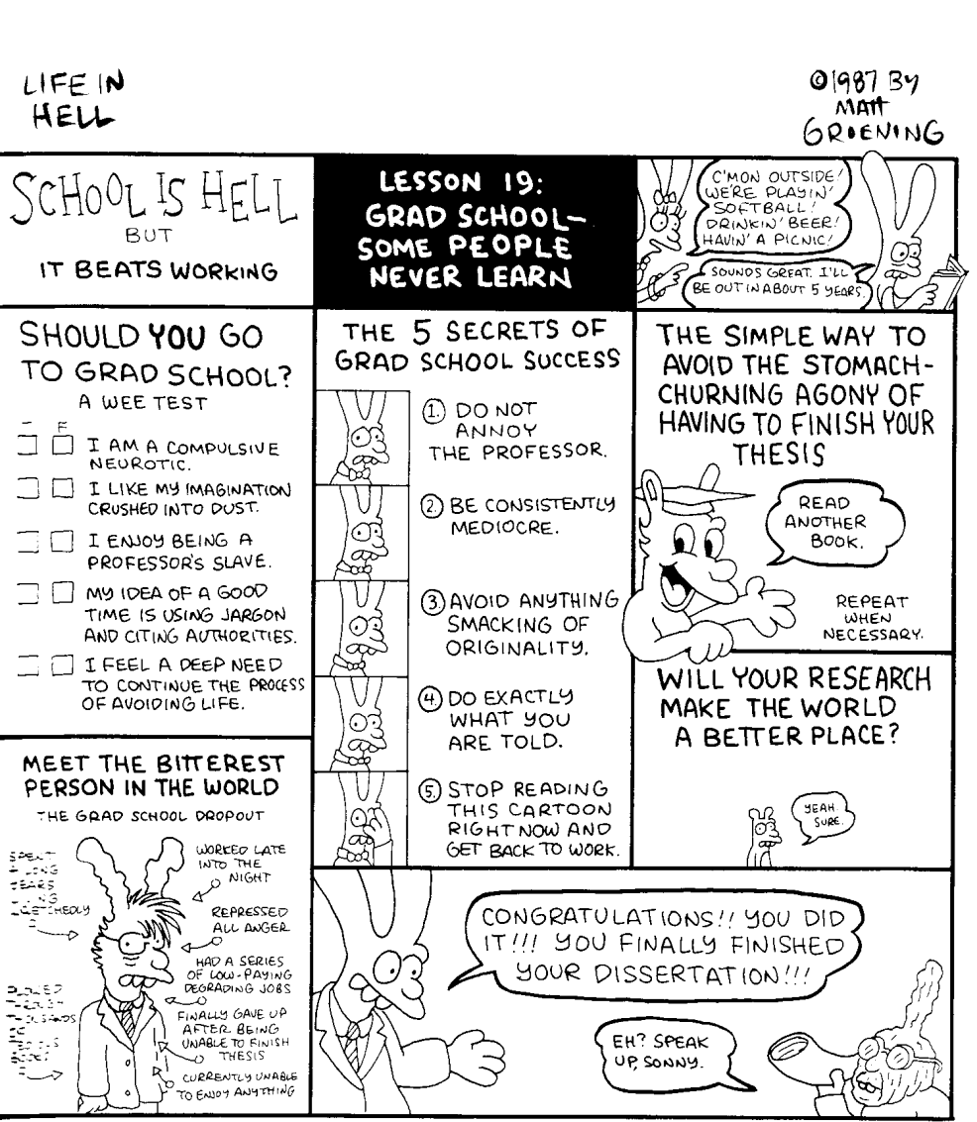

Slide 5
WHEN LOSSES OCCUR
The results remain fairly constant, even over decades (1964, 1996, 2000).
80% are lost before the ABD (All But Dissertation) level.
20% are lost very close to the goal, having completed everything but the dissertation and defense.

Slide 6
FACTORS AFFECTING COMPLETION
1. Supply and Perceived Demand: Breneman’s Economic Theory of Graduate Attrition suggests that high graduate losses aid departments.
More survivors would flood the market after higher-tier placements.
When there is a greater perceived market for prime placements, then more are gradated.

Slide 7
FACTORS AFFECTING COMPLETION
2. Latent Goals: High attrition rates function for departments due to their use of TAs (Teaching Assistants) for teaching loads.
In some schools, a Bachelor’s student may go their entire four years and never see a professor.

Slide 8
FACTORS AFFECTING COMPLETION
3. GRE: (Graduate Record Exam)
GREs are used to screen applicants with the belief that high GRE scores indicate a student more likely to complete than one with lower scores.
The tests turn out not to have the predictive ability many expect of them.

Slide 9
FACTORS AFFECTING COMPLETION
4. Selection Processes:
“Weeding Out” uses a very critical process looking for grounds to disqualify, leaving a core seemingly more likely to succeed.
“Screening In” takes all candidates that meet minimum criteria, and lets processes in the department cull the herd. They take any with a pulse and minimums, but plenty of opportunity exists for later exit.

Slide 10
FACTORS AFFECTING COMPLETION
5. Teaching Assistanceships versus other forms of funding.
TAs tend to have higher rates of attrition as opposed to those with research funding, and longer TTDs.

Slide 11
FACTORS AFFECTING COMPLETION
6. Funding and TTD: Attempts made to reduce the time in program by regulating financial support and duration would seem an answer.
A major initiative by the Ford Foundation failed miserably in this approach, with no significant changes in the TTD or attrition rates.

Slide 12
FACTORS AFFECTING COMPLETION
7. Mentoring: Success rates were higher in departments with supportive mentoring faculty.
Many non-completers report toxic environments and little support while attempting to complete their program.
Intradepartmental politics also affected success rates.

Slide 13
FACTORS AFFECTING COMPLETION
8. SUCK IT UP, BUTTERCUP!
Common reactions to the situation repeat again and again.
“Why should they have an easier time than I had? I got through it.”
“If they can’t handle that, then we don't need them.”

Slide 14
THE CHARGE
We are an academic discipline, and these attrition rates indicate inefficiency and an uncaring approach to the next generation of scholars.
As a discipline, we are small and tight-knit enough to try to find new strategies and information, and share discipline-wide.
We could even find the answers that plague all of the Humanities and Social Sciences, demonstrating utility and expertise beyond more established ones.

Slide 15
THANK YOU FOR YOUR TIME AND ATTENTION

