Slide 1
The Interactive Effects of Education, Age, Race, and Gender on Inmate Recidivism
By Austin O'Neill and Rebecca Tibbs

Slide 2
Recidivism
A person's return to criminal behavior after his or her initial incarceration

Slide 3
Measuring Recidivism
By Arrest
By Conviction
Re-Incarceration
Georgia

Slide 4
Modern Context of Recidivism
All Offenders Women Offenders
Within 3 years 68%
within 5 years 75% 44%

Slide 5
Measuring Recidivism
Reconvicted Re incarcerated
1. White 19% 14%
2. African American 22% 16%
3. Latinos 9% 8%
4. Asian 16% 10%
5. Other 11% 7%

Slide 6
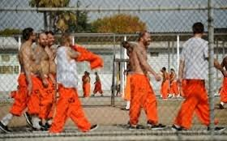
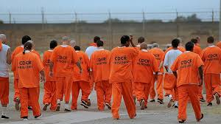
Measuring Recidivism
Rearrested Reconvicted Reincarcerated
1. White 58% 38% 20%
2. Black 70% 48% 28%
3. Hispanic 60% 40% 22%

Slide 7
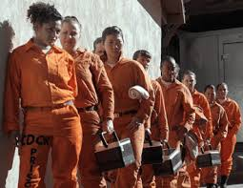
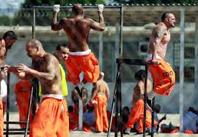
Gender and Recidivism
Reconvicted Returned to prison
Female - 15% 7%
Male - 21% 16%

Slide 8
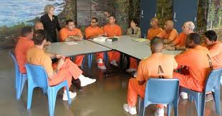
Gender and Recidivism
Rearrested
Female 50%
Male 66%

Slide 9
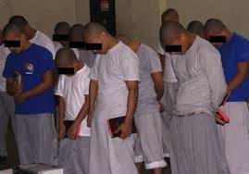
Age and Recidivism
Reconvicted Returned to prison
Younger than 21: 35% 27%
Older than 21: 20% 15%

Slide 10
Effects of Education
Recidivated
Educated in Prison 25%
No Prison Education 40%

Slide 11
Findings
1. Women reoffend less than men
2. Older offenders recidivate less
3. African Americans recidivate the most of any racial group
4. Education has a positive impact on recidivism

