Slide 1
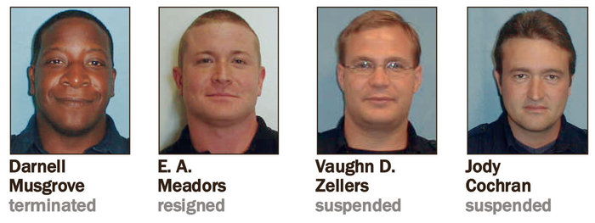
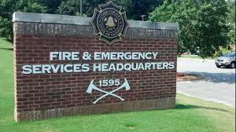
LIARS in Public Safety: Case Studies in Deception
Stan Crowder, Ph.D.
Assistant Professor of Criminal Justice
Kennesaw State University

Slide 2
LIARS in Public Safety: Phillip R. Wilbur, Junior …the named Drug Dealer

Slide 3
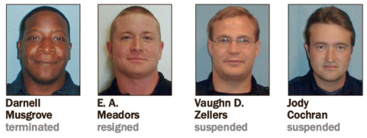
Headlines: Steroid abuse investigation targets Cobb firefighters, police
Cobb County government officials are conducting an investigation following claims that five county firefighters and a police officer may have consumed and/or distributed steroids without prescriptions.
County officials were notified by the Marietta Cobb Smyrna Narcotics Unit that a county employee may have illegally used steroids. An investigation by the county’s internal affairs unit and legal department began the week of May 20 and remains active.
The investigation, originally focused on one former firefighter accused of using steroids in 2010, expanded following additional claims that other firefighters and a police officer could be involved, county spokesman Robert Quigley said.
Read more: The Marietta Daily Journal - Steroid abuse investigation targets Cobb firefighters police by Jon Gillooly July 01, 2013

Slide 4
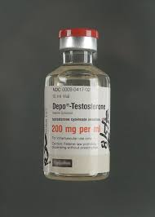
LIARS in Public Safety: Case Studies in Deception
Anabolic Steroids are Schedule III drugs in accordance with the Controlled Substances Act.
These synthetic substances related to testosterone are “anabolic: revealing the drug’s ability to create skeletal muscle growth”.
It is a felony to possess, sell, use, and distribute these drugs outside of a very narrow scope of human and animal medical needs.
So police officers and firefighters are using an anabolic steroid that veterinarians provide horses?

Slide 5
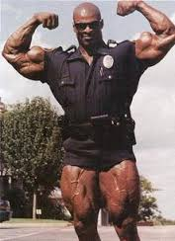
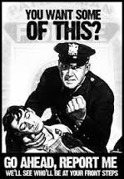
LIARS in Public Safety: Case Studies in Deception
Case Study Research
Transcribed verbal statements in three (3) internal affairs investigations
One video recording available
Examination of the veracity of statements
Application of study of language. Linguistics, to the policy, procedures or law = Forensic Linguistics
Goal = Examination to ascertain if deception can be determined

Slide 6
LIARS in Public Safety: Case Studies in Deception
Detecting Deception
Based on the anxiety created by the interview
Subjects
Take longer to answer
Give shorter answers
Liars give less details…lack clarity (particularly about time)
Liars repeat earlier statements (inflexible … adhere to repeating the same lie over and over)
Sequence of events will be disordered

Slide 7
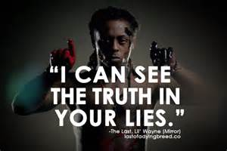
LIARS in Public Safety: Case Studies in Deception
Detecting Deception: Quantity of Information does not equal Quality of Information
Pronoun usage offers the greatest opportunity for providing insight into a liar’s thinking
Changing “I” to “We” lessens responsibility
Verb Tense usage: past events may be recounted in the present tense…people fabricate event as if it is taking place
Unnecessary Information: substitute for missing information and extraneous info…e.g. how to build a watch vs. what time it is
Time Insight: examining when time is absent from a narrative or where there are clusters of time
Minimizing and editing adverbs, changes in nouns, changes in verbs

Slide 8
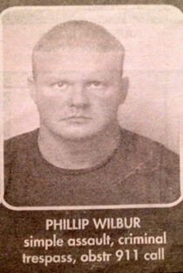
LIARS in Public Safety: Case Studies in Deception
One Examination Today: Phillip R. Wilbur, Jr.
Statement Examination by comparing and contrasting excerpts to the following statement analysis criteria.
Fewer details (noted in Gordon & Fleisher, Leins, et al. and Warmelink, et al.)
Speech hesitations (noted in Olsson and Warmelink, et al.)
Repeating statements (noted in Leins, et al.)
Time clarity (noted in Gordon & Fleisher, Olsson, and Warmelink, et al.)
Narrative sequence (Matsumoto and Olsson)
Pronoun shift (noted in Gordon & Fleisher, Hess, and Matsumoto)
Verb Tense (noted in Hess, Matsumoto, and Olsson)
Excessive details / unnecessary phrases (Matsumoto and Olsson).

Slide 9
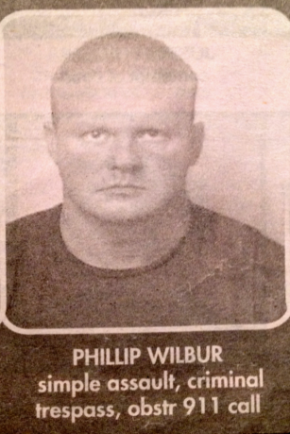
LIARS in Public Safety: Case Studies in Deception
The Dealer- Phillip R. Wilbur, Jr.
Came to the attention of IA investigators after 2 arrests in April 2011.
Admitted to taking illegal anabolic steroids, Trenabol and Deca.
Positive drug test for Boldenone and Nandrolone, illegal anabolic steroids.
Later employed with Smyrna Fire Department and allowed to resign after being found in felony possession of illegal anabolic steroids on city property.
No Criminal Investigation ever conducted and no arrest by any agency.

Slide 10
LIARS in Public Safety: Case Studies in Deception
Hand-out of Wilbur Statement One
Discussion
Hand-out of Wilbur Statement Two
Discussion
Hand-out of Wilbur Statement Three
Discussion
Wilbur is a LIAR.

Slide 11
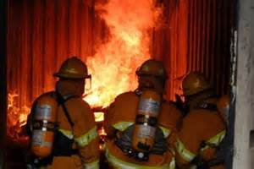
LIARS in Public Safety: Case Studies in Deception
Firefighters Cochran, Musgrove, Nemeth, and Zellers statements are reveal: they are LIARS.
Police Officer Meadors: LIAR.
Outcomes:
Cochran suspended
Musgrove fired
Nemeth resigned
Zellers suspended
Meadors resigned (POST certification revoked)

Slide 12
LIARS in Public Safety: Case Studies in Deception
Lessons Learned
Just because they wear a badge does not mean they won’t lie to you.
Training requirements for Internal Affairs investigators.
Use in obtaining confessions.
Pre-Employment Interviews.
Wilbur Outcome (I thought you’d never ask)
Resigned from Cobb FD
Hired by Austell FD; then Smyrna FD; then Atlanta FD
No criminal investigation…ever
Eventually prosecuted for forgery in first degree (felony) after forging a drug test in a civil case
Firefighter and Paramedic License revoked in 2015

