Slide 2
William Benzur Georgia College & State University Milledgeville Georgia’s Public Liberal Arts University 770 634 4170 WLBENZUR@AOL.COM And Charles Ubah Georgia College & State University Milledgeville Georgia’s Public Liberal Arts University 478 445 7392 CHARLES.UBAH@GCSU.EDU

Slide 3
Youth Fire Setters and the Juvenile Justice System:
Lesson for Policy Makers

Slide 4
Quick Facts
Arson is one of the most costly crimes
(>2 Billion annually)
Juveniles are responsible for 50 – 60% of those crimes.
American children set about 150,000 fires a year

Slide 5
“Youth Firesetter”
vs.
“Juvenile Arsonist”

Slide 6
Curious/Experimenter
Crisis/Troubled/Cry for Help
Thrill Seeker/Risk Taker
Criminal Delinquent
Pathological

Slide 7
Curious/ Experimenter
3-5 year olds
Simple ignition
Adventurous
Accidental / Innocent
Embarrassment / guilt
Self reported

Slide 8
Crisis/Troubled/Cry For Help
Secondary issue
Anger management
Form of expression
Symbolism
Specific targets
Justified

Slide 9
Thrill Seeker/Risk Taker
Danger is fun
Creative ignition
Accelerants common
Poor judgment
Peer influence / Crowd pleaser
“Good kids”

Slide 10
Delinquent/Strategic/Criminal
Willful intent to cause destruction
Schools, abandoned buildings, dumpsters and open fields
Glory / Crime concealment / Revenge
Behavioral issues
Fires are well planned
Pride

Slide 11
Pathological/Severely Disturbed
Unaddressed fire setting behavior
Gratification
Hundreds to thousands of fires
Patterns and rituals
Bed wetting and/or animal cruelty
Denial of involvement
Dysfunction and/or abusive home

Slide 13
What type of firesetter did we just witness?
1. Curious/Experimenter
2. Crisis/Troubled/Cry for Help
3. Thrill Seeker/Risk Taker
4. Criminal Delinquent
5. Pathological

Slide 14
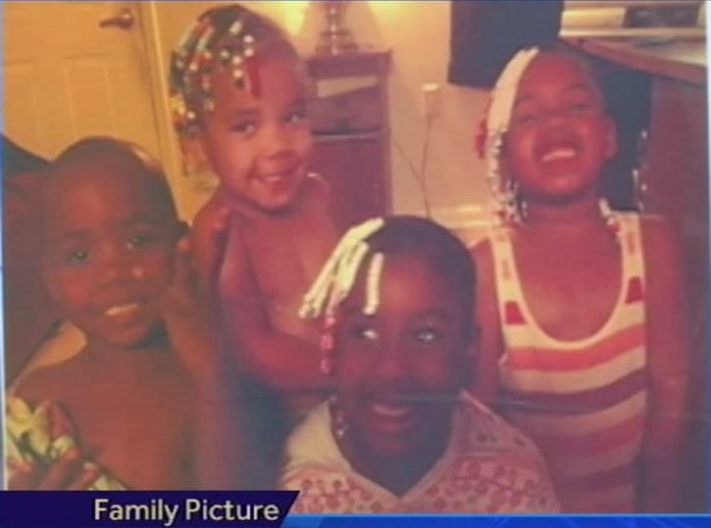
Pictured: Tai'zah Hughes (6), Tatyana Hughes (5), Tyrese Hughes (4), Trinity Hughes (2)

Slide 15
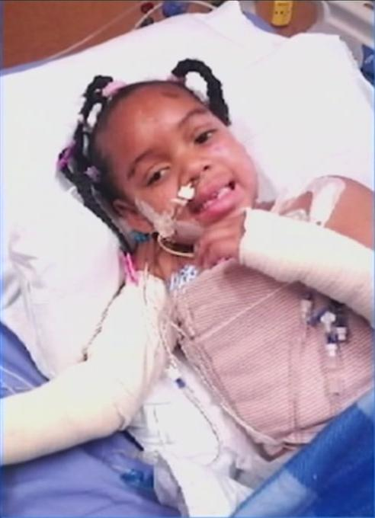
Pictured: Tatyana with burns covering 20% of her body

Slide 16
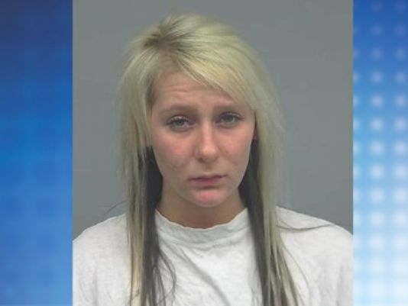
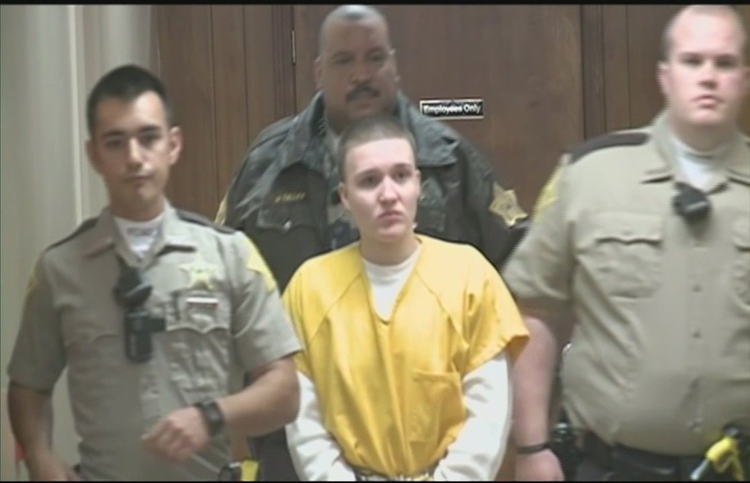
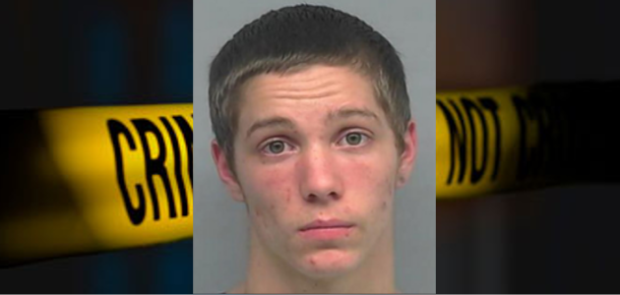
Kylie Jenks
Shelby Markowsky
Cody Cashion

Slide 17
What type of firesetter is
Cody Cashion?
1. Curious/Experimenter
2. Crisis/Troubled/Cry for Help
3. Thrill Seeker/Risk Taker
4. Criminal Delinquent
5. Pathological

Slide 18
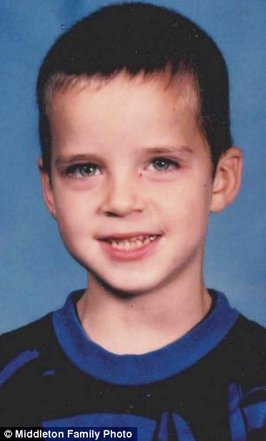

Slide 19
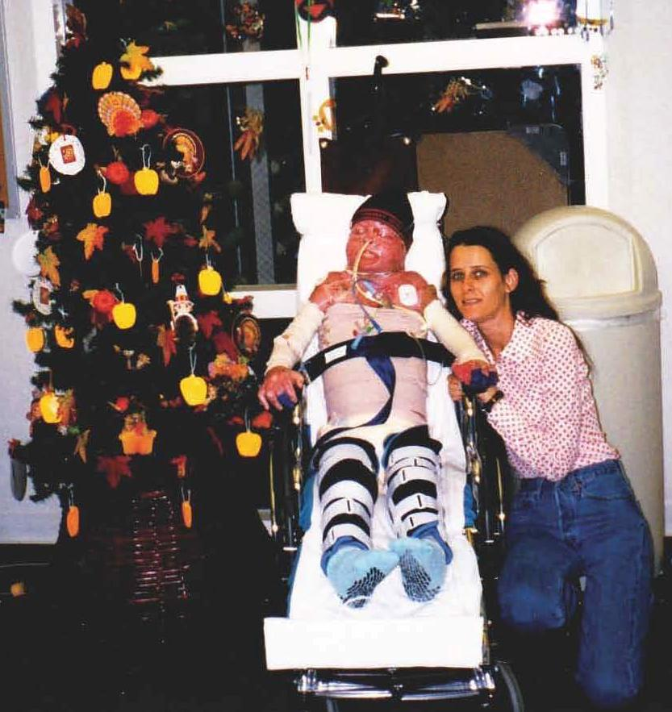

Slide 20
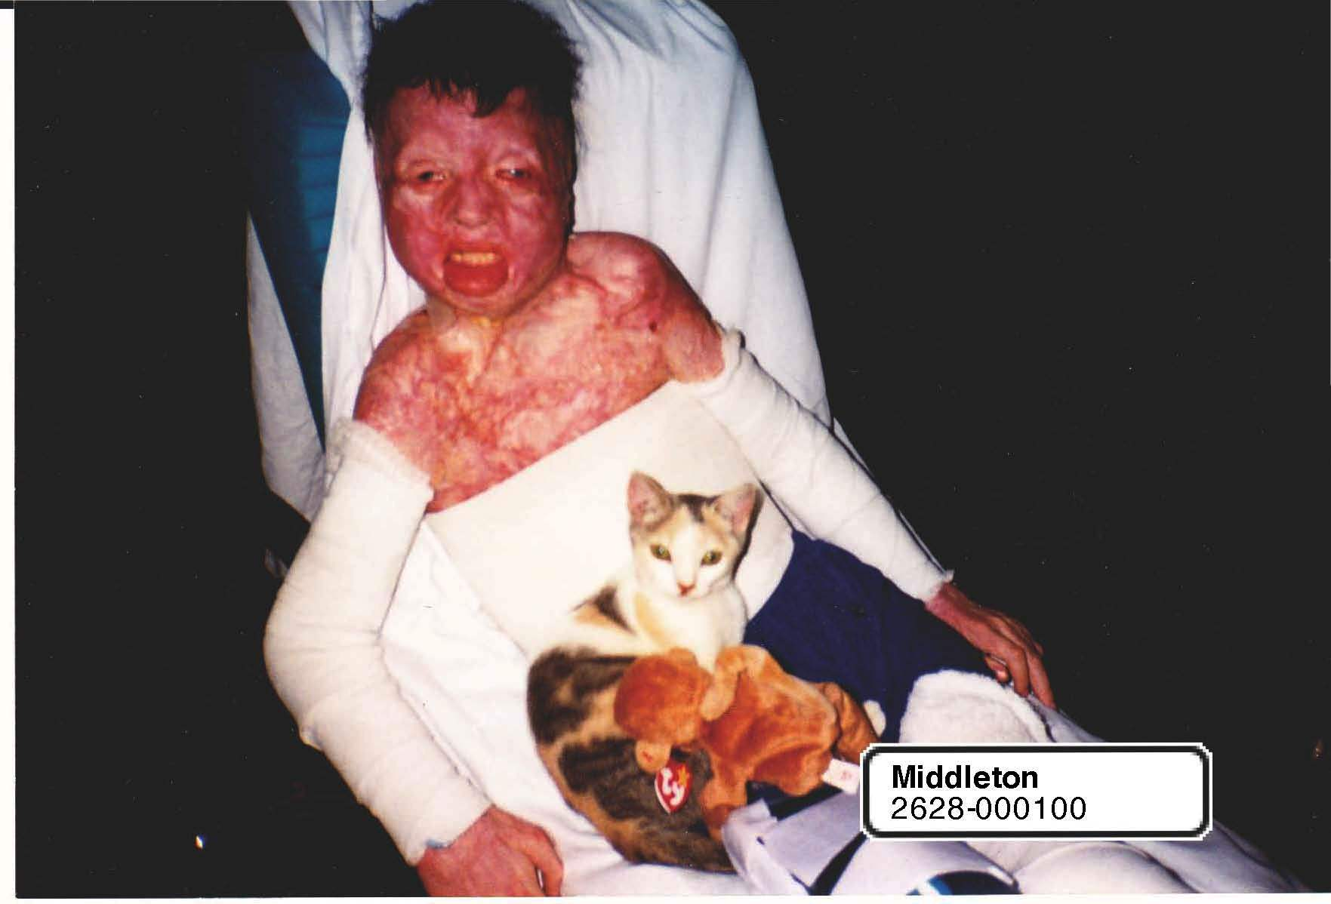

Slide 21
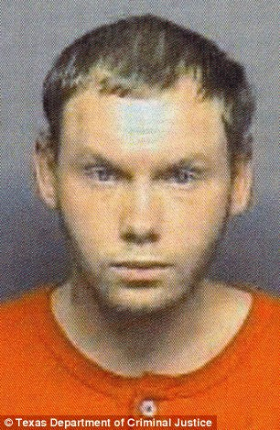
Pictured: Don Collins

Slide 22
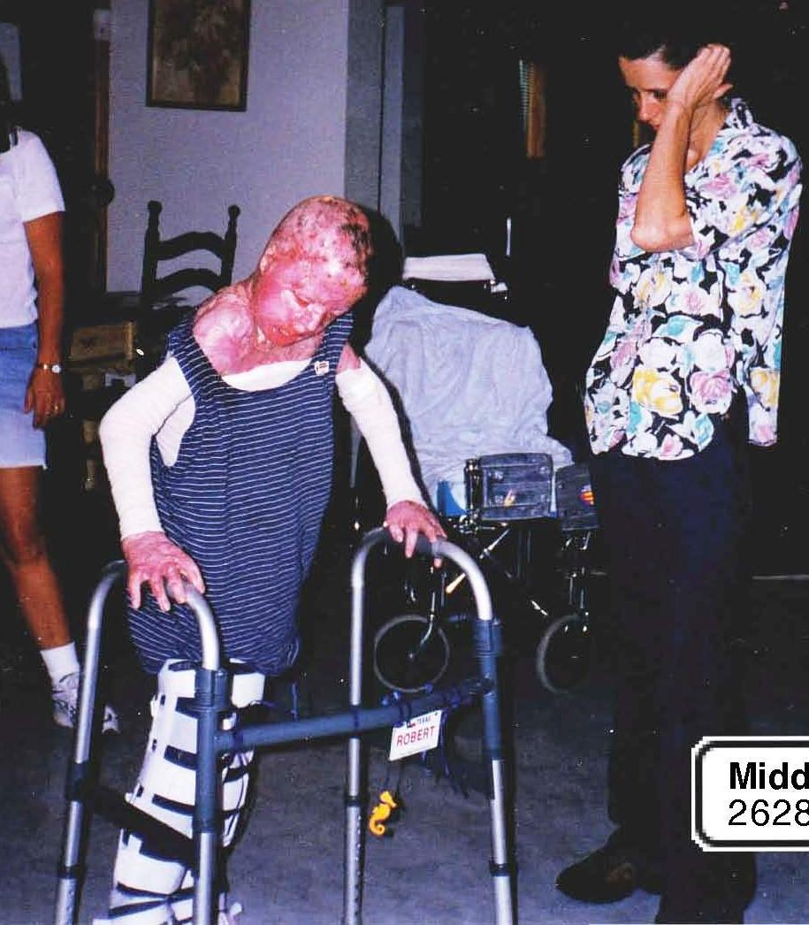

Slide 23
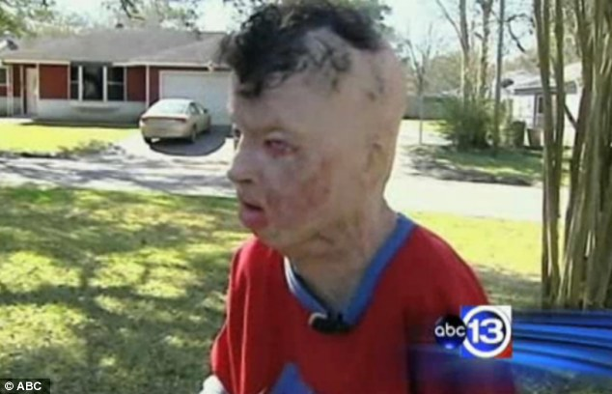

Slide 24
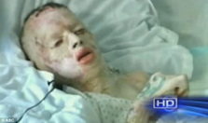

Slide 25
What type of firesetter is
Don Collins?
1. Curious/Experimenter
2. Crisis/Troubled/Cry for Help
3. Thrill Seeker/Risk Taker
4. Criminal Delinquent
5. Pathological

Slide 28
William Benzur Georgia College & State University Milledgeville Georgia’s Public Liberal Arts University 770 634 4170 WLBENZUR@AOL.COM And Charles Ubah Georgia College & State University Milledgeville Georgia’s Public Liberal Arts University 478 445 7392 CHARLES.UBAH@GCSU.EDU

