Slide 1
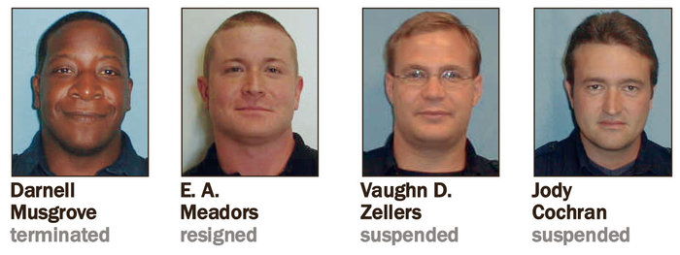
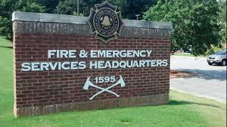
Siren Call to Syringe: The Use and Abuse of Anabolic Steroids in Public Safety
Stan Crowder, Ph.D.
Assistant Professor of Criminal Justice
Kennesaw State University

Slide 2
Siren Call to Syringe: The Use and Abuse of Anabolic Steroids in Public Safety- Phillip R. Wilbur, Junior …the named Drug Dealer

Slide 3
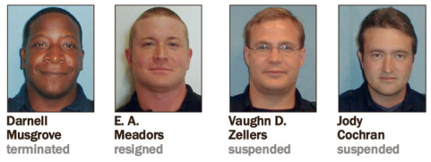
Headlines: Steroid abuse investigation targets Cobb firefighters, police
Cobb County government officials are conducting an investigation following claims that five county firefighters and a police officer may have consumed and/or distributed steroids without prescriptions.
County officials were notified by the Marietta Cobb Smyrna Narcotics Unit that a county employee may have illegally used steroids. An investigation by the county’s internal affairs unit and legal department began the week of May 20 and remains active.
The investigation, originally focused on one former firefighter accused of using steroids in 2010, expanded following additional claims that other firefighters and a police officer could be involved, county spokesman Robert Quigley said.
Read more: The Marietta Daily Journal - Steroid abuse investigation targets Cobb firefighters police by Jon Gillooly July 01, 2013

Slide 4
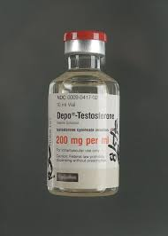
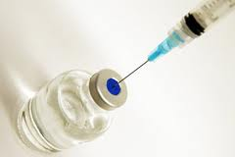
Siren Call to Syringe: The Use and Abuse of Anabolic Steroids in Public Safety
Anabolic Steroids are Schedule III drugs in accordance with the Controlled Substances Act.
These synthetic substances related to testosterone are “anabolic: revealing the drug’s ability to create skeletal muscle growth”.
It is a felony to possess, sell, use, and distribute these drugs outside of a very narrow scope of human and animal medical needs.
So why are police officers and firefighters using an anabolic steroid that veterinarians provide horses?

Slide 5
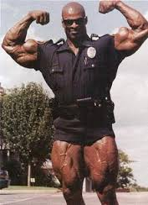
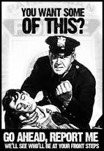
Siren Call to Syringe: The Use and Abuse of Anabolic Steroids in Public Safety
Why?
Increased physical strength
Reduce body fat; improve appearance
Heightened sense of self-esteem;
Job performance on the “mean streets”
Sense of euphoria
What About…side effects?
Users often turn to opioids to counteract the insomnia and irritability from anabolic steroids
Users deal with criminals to buy illegal anabolic steroids and become criminals when the purchase, transport, and use these drugs.
Aggressive behavior, mood swings, forgetfulness, distraction, depression, hallucinations, and delusions.

Slide 6
Siren Call to Syringe: The Use and Abuse of Anabolic Steroids in Public Safety
Police Officer Eric Meadors
Meadors came to the attention of internal affair investigators when he was named as a suspected drug buyer from a former Cobb County firefighter- Phillip Wilbur. Meadors did admit to buying drugs from Wilbur.
Admitted to the purchase and use of illegal anabolic steroids after testing positive for Boldenone, an anabolic steroid for horses. This act reveals Meadors is a felon.
Motivation - Eric Meadors stated, “to maintain my edge.”
Meadors admitted to using illegal anabolic steroids for three to four years; resigned in lieu of firing; and has been decertified by GA Peace Officers Standards and Training Council.

Slide 7
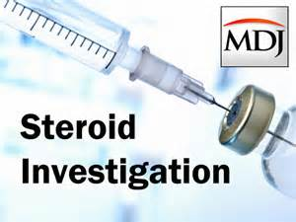
Siren Call to Syringe: The Use and Abuse of Anabolic Steroids in Public Safety
Firefighter Darnell Musgrove
Musgrove also named as a suspected drug purchaser and he did admit to buying illegal anabolic steroids from Wilbur.
Admitted to using as far back as 2007 and was in possession of illegal anabolic steroids.
Motivation – “it helps ah, ah, sexual performance…”
Musgrove admitted to buying and selling drugs to other firefighters.
Musgrove was a felon and had been a felon since 2007.

Slide 8
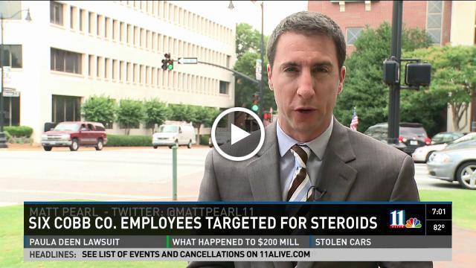
Siren Call to Syringe: The Use and Abuse of Anabolic Steroids in Public Safety
Firefighter Vaughn “Charlie” Zellars
It was the second interview that Zellars becomes truthful. He admitted to purchasing illegal anabolic steroids from Phillip Wilbur.
“I wanted to get back in shape and start to date again…”
Zellars denies buying from Musgrove, but admits…”I’ve taken it, I’ve bought it, I’ve done it…”
Zellars is therefore an admitted felon.

Slide 9
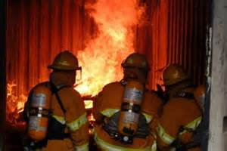
Siren Call to Syringe: The Use and Abuse of Anabolic Steroids in Public Safety
Firefighter Craig A. Nemeth
Nemeth quickly admitted to IA investigators his use of illegal anabolic steroids and his purchase of them from Phillip Wilbur at Wilbur’s home.
Provides insight that the drug dealer, Wilbur, provided syringes and needles to inject the illegal drugs.
Admits to selling some drugs back to Wilbur.
Resigned quickly.

Slide 10
Siren Call to Syringe: The Use and Abuse of Anabolic Steroids in Public Safety
Engineer Firefighter Jody Cochran
Cochran quickly admitted to buying drugs from Wilbur and from an internet site “TradeKey”
Admitted to purchasing drugs at Wilbur’s home and at a public park where Wilbur’s son was playing in a football game.
After admissions of felony criminal conduct, Cochran attempted to beat the polygraph administered at the direction of IA…”It is the belief and opinion that Jody had knowingly and purposefully engaged in an attempt to beat the test by manipulating his breathing and excessive foot movement.”

Slide 11
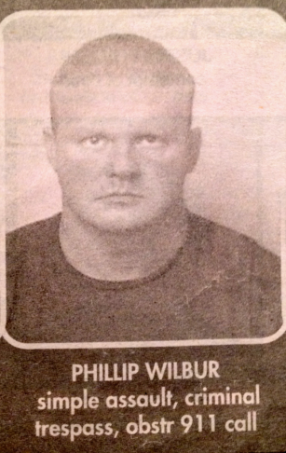
Siren Call to Syringe: The Use and Abuse of Anabolic Steroids in Public Safety
The Dealer- Phillip R. Wilbur, Jr.
Came to the attention of IA investigators after 2 arrests in April 2011.
Admitted to taking anabolic steroids, Trenabol and Deca.
Positive drug test for Boldenone and Nandrolone.
Later employed with Smyrna Fire Department and allowed to resign after being found in felony possession of illegal anabolic steroids on city property.
No Criminal Investigation ever conducted and no arrest by any agency.

Slide 12
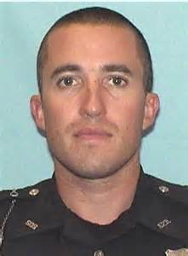
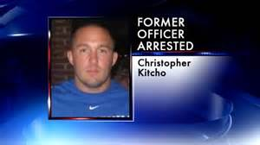
August 19, 2014- Quit in lieu of Firing
Kitcho showed an APD badge while being questioned by DeKalb police for an alcohol related citation. Atlanta investigators said that once inside the former officer's apartment they found cocaine, marijuana, anabolic steroids and a rifle.

Slide 13
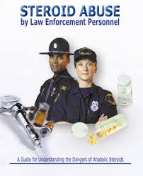
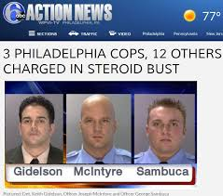
This is NOT New News
1991 FBI Law Enforcement Bulletin…Abuse of Anabolic Steroids
2004 DEA pamphlet…Steroid Abuse by Law Enforcement Personnel
2008 The Police Chief…Anabolic Steroid Use and Abuse by Police Officers
2012 Culture and Society: Journal of Social Research…Vocational Steroid Use

Slide 14
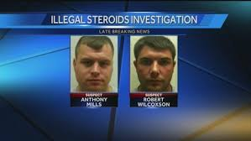
It is ALL about LEADERSHIP
Cobb County Leadership Takes a NAP…
NO criminal investigation on any person
NO mandatory anabolic drug testing at PD or FD
Specific Panel is required to test for anabolic steroids
Bad publicity does not get better with age.
Liability issues abound…use of force.
Illegal drug use and insurance costs to the local governments.

